Slide 1
Laser-Based Wireless Power Transmission Receiver’s Energy Harvester: Photovoltaic Power Converter Board
Haruka Kido
University of North Dakota
EE481. Senior Design II

Slide 2
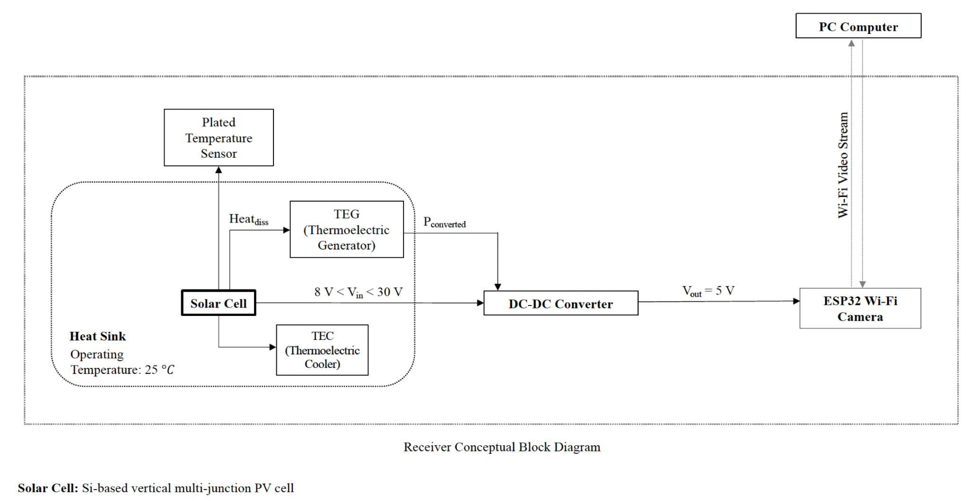
Receiver Conceptual Block Diagram

Slide 3
Design Objective: Rapid Prototyping for Testing
To replace the isolated LM2596 DC-DC Converter board with a compact Power Converter solution combined with a thermal regulation and energy harvesting system
To provide a spatial layout for the PV cells with consideration to the TEC’s placement beneath the board
To implement either the Buck “step-down” or Boost “step-up” voltage converter mechanism from the quad-PV array to the camera load (Note: The selection between Buck or Boost DC-DC Converter depends on wattage output from the 4 PV cells)
To implement a voltage-controlled power electronic system with ON-OFF switching and low-pass filter or to provide an extension board to do so
To make a top-layer backplane system so the PV cells can be easily soldered to the PCB solder pads without electrode wiring or external cabling and so the load camera can also be soldered to the load output connector
To minimize conduction losses and use power distribution techniques in a condensed form
To verify the highest efficiency power converter board as part of the testing and performance evaluation
To provide boards with test pads for fault detection during testing

Slide 4
Design Tools
TI WEBENCH Power Designer
Autodesk EAGLE
Digi-Key’s PCB Trace Width Calculator
PCB fabrication machines
Soldering equipment

Slide 5
PV Cell Form Factors
39.37008 mils = 1 mm
1 mil = 0.0254 mm (millimeter)
1 cm x 1 cm (10 mm x 10 mm) MIH® VMJ PV Cell Form Factor (Part #: 5S1010.4)
2.5 cm x 2.5 cm (25 mm x 25 mm) PV Cell Form Factor
5 cm x 5 cm (50 mm x 50 mm) PV Cell Form Factor
Total number of form factors: 3
PV Cell Electrical Arrangement Types
Isolated: Configurable Externally for Adaptive Methods
Series
Parallel
Total number of arrangements: 3
Total number of possible board prototypes: 9
Total number of design files for board prototypes: 7 (due to adjustable dimensions and tolerances from same circuitries)

Slide 6
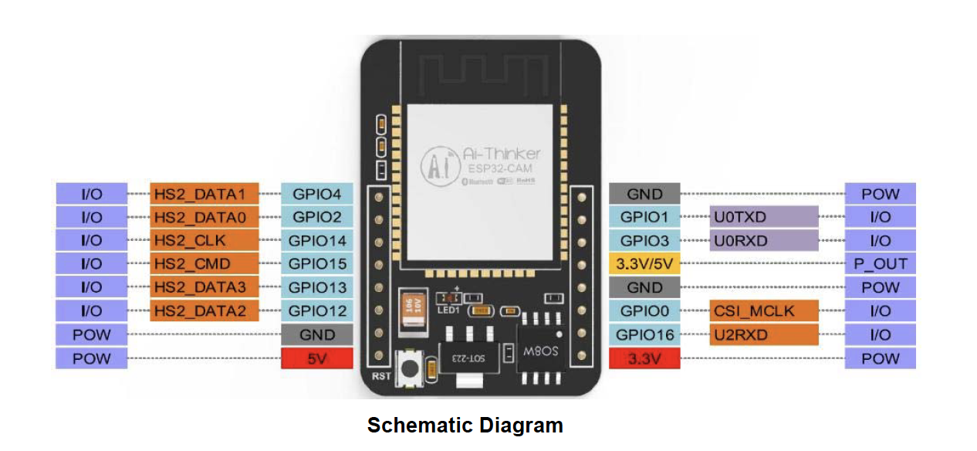
ESP-32 Wi-Fi Load Input Requirements
Power consumption is
(180 mA x 5V) = 900mW = 0.9 W
(Flash OFF)

Slide 7
Circuit Design # | PV Cell Arrangement Type | Number of PV Cells | PV Cell Form Factor | DC-DC Converter Type | Voltage Output | Output Current | Expected 5V at 0.18 A achieved for load? (Y/N)
1 | Series | 4 | 1 cm x 1 cm (10 mm x 10 mm) | Separate Buck | Vout = 29.21 V x 4 PV cells = 116.84 V | 0.02029 A
2 | Isolated | 1 | 1 cm x 1 cm (10 mm x 10 mm) | Internal Buck | Vout = 29.21 V x 1 PV cell = 29.21 V | 0.02029 A
3 | Parallel | 4 | 1 cm x 1 cm (10 mm x 10 mm) | Internal Buck | Vout = 29.21 V | 0.02029 A x 4 PV cells = 0.08116 A
4 | Parallel | 4 | 2.5 cm x 2.5 cm (25 mm x 25 mm) | Separate Boost | Vout = 2.23 V | 0.0472 A at Pmpp
5 | Series | 4 | 2.5 cm x 2.5 cm (25 mm x 25 mm) | Internal Buck | Vout = 2.23 V x 4 PV cells = 8.92 V | 0.0472 A at Pmpp
6 | Series | 4 | 5 cm x 5 cm (50 mm x 50 mm) | Internal Buck | Vout = 2.43 V x 4 PV cells = 9.72 V | 0.14 A
7 | Series | 4 | 5 cm x 5 cm (50 mm x 50 mm) | Separate Buck | Vout = 2.43 V x 4 PV cells = 9.72 V | 0.14 A
8 | Parallel | 4 | 2.5 cm x 2.5 cm (25 mm x 25 mm) | Separate Boost | Vout = 2.23 V | 0.0472 A at Pmpp
9 | Parallel | 4 | 5 cm x 5 cm (50 mm x 50 mm) | Separate Boost | Vout = 2.23 V | 0.14 A x 4 PV cells = 0.56 A

Slide 8
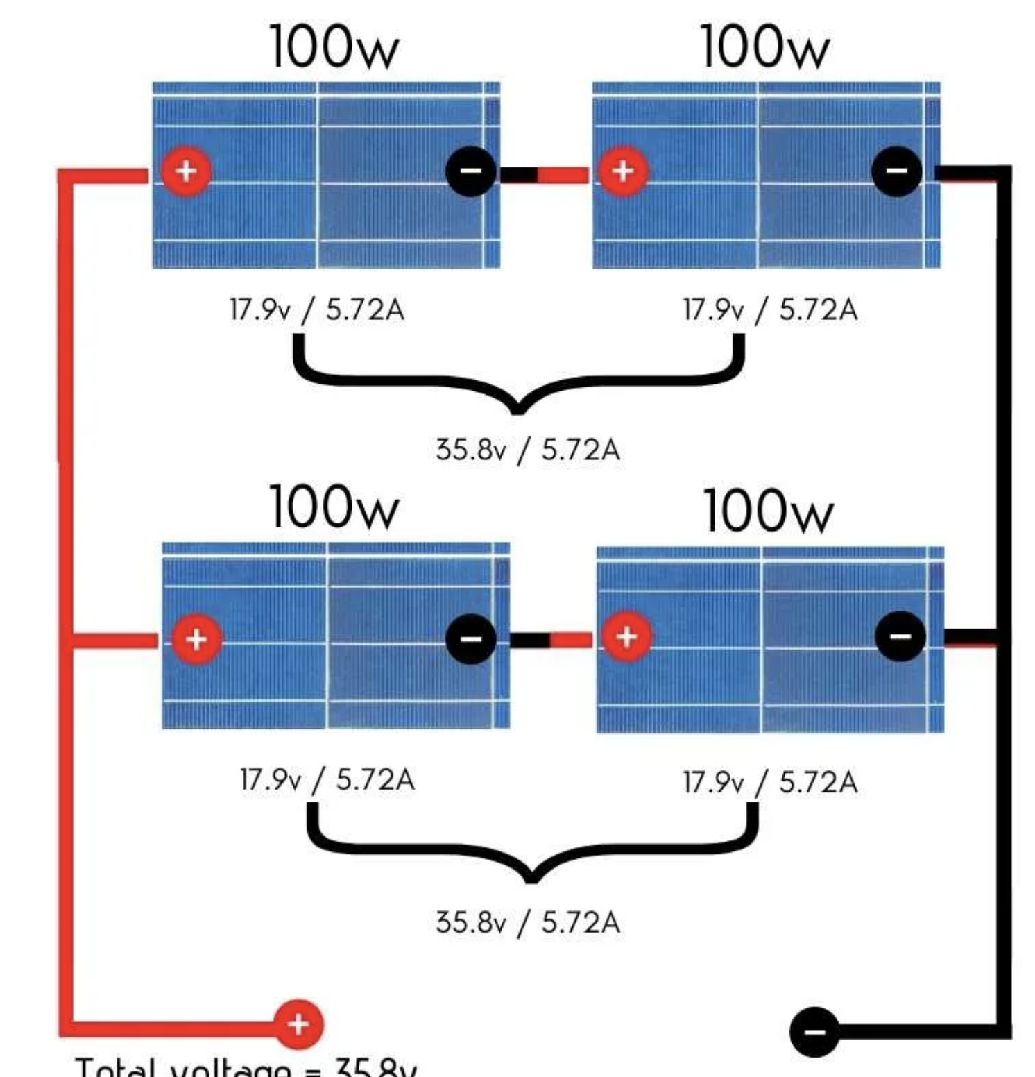
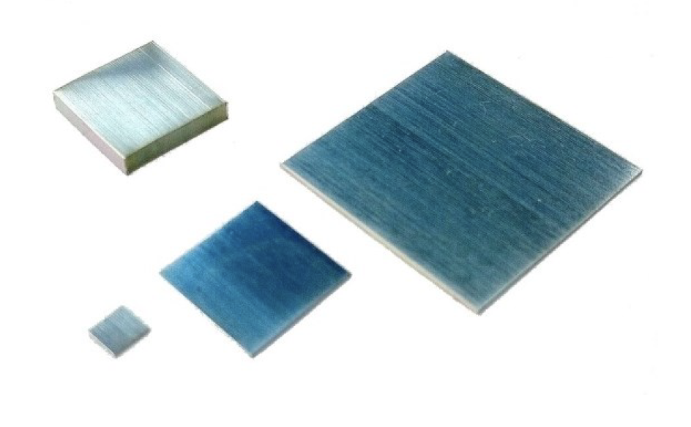
1. Design Specifications 1 cm x 1 cm MIH® VMJ PV Cell Form Factor, 4-PV, Series; Extension Board: Configurable for Externally Adaptive Load Circuitry
Peripherals:
Inputs:
PV Array: 2 leads (+ and -) x 4 PV cells = 8 leads
TEG module’s 2 leads (+ and -)
TEC module’s 2 leads (+ and -)
Outputs:
ESP-32 Wi-Fi camera
Internals:
Pads for soldered PV cells
I/O Ports as Female Connectors
Voltage Requirements:
Input:
Each PV cell has a 0.02029 A maximum current output
Each PV cell has a 29.21 V maximum voltage output
Each PV cell has a 0.59267 W maximum power output
Total max V_{out} = 29.21 V x 4 PV cells; Voltage output = 116.84 V for a series connection
Total max current = 0.02029 A for a series connection
Output: 5 V at 180 mA *or .18 A = 0.9 W
Miscellaneous:
Heat Sink
*Required Separately: Buck DC-DC Converter circuit: 116.84 V to 5 V

Slide 9
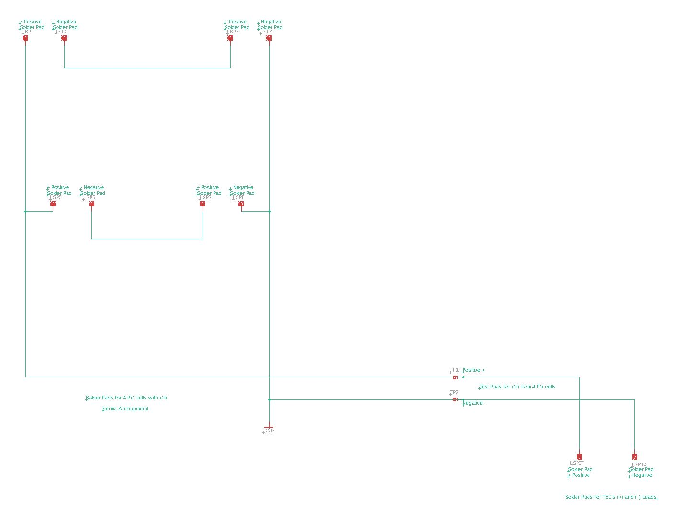
1.

Slide 10
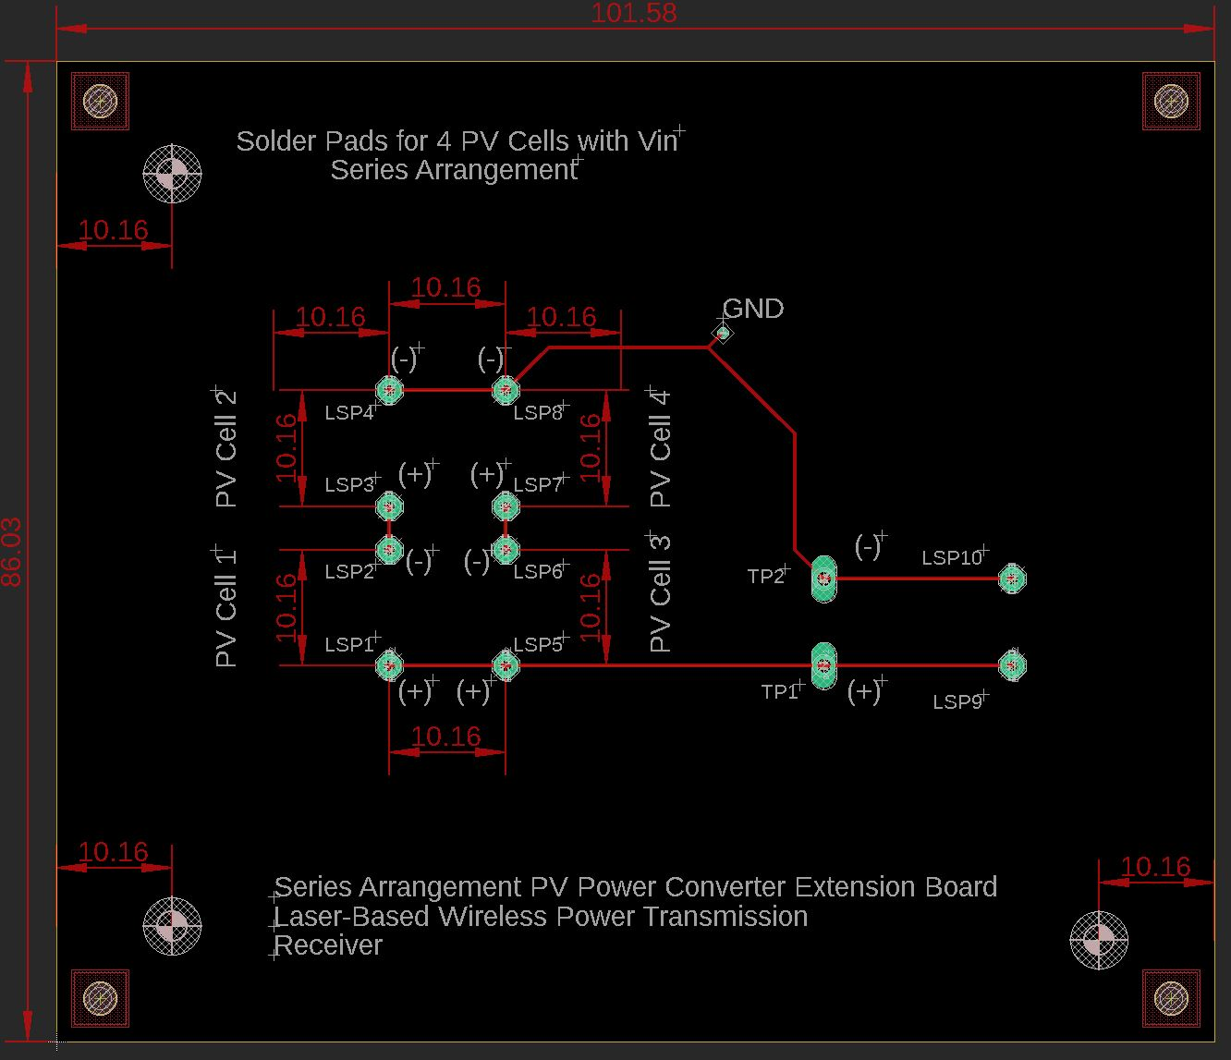
1.

Slide 11
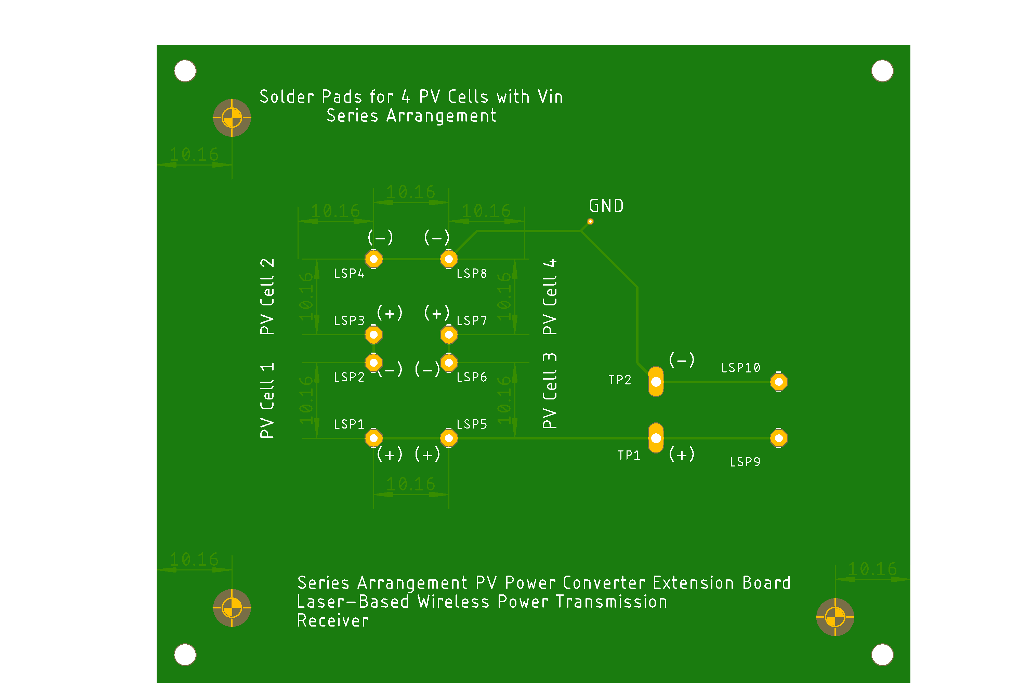
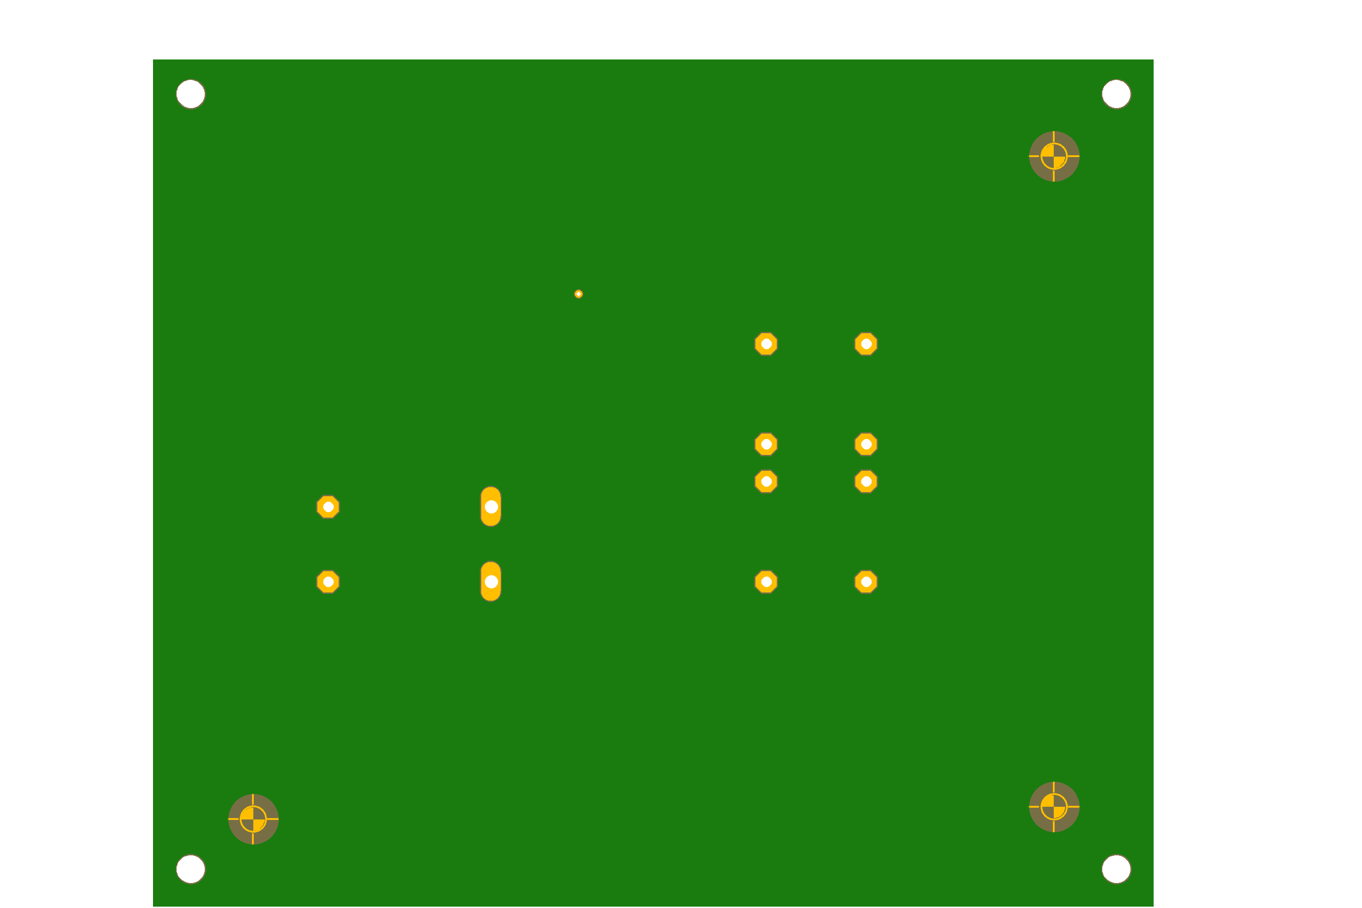
1.
Top
Bottom

Slide 12
2. Design Specifications 1 cm x 1 cm MIH® VMJ PV Cell Form Factor, 1-PV; Full Backplane Board
Peripherals:
Inputs:
PV Array: 2 leads (+ and -)
TEG module’s 2 leads (+ and -)
TEC module’s 2 leads (+ and -)
Outputs:
ESP-32 Wi-Fi camera
Internals:
Pads for soldered PV cells
PWM Control DSP, MCU, or FPGA for Switch Control
Buck DC-DC Converter circuit with Low-Pass Filter: 29.21 V to 5 V
- R, L, C, MOSFET Switch (Voltage-Controlled)
I/O Ports as Female Connectors
Voltage Requirements:
Input: 8 - 30 V:
Each PV cell has a 0.59267 W maximum power output
Each PV cell has a 29.21 V maximum voltage output
Total max V_{out} = 29.21 V x 1 PV cell; Voltage output = 29.21 V for a single PV solution
Total max current = 0.02029 A for a single PV solution
Output: 5 V at 180 mA *or .18 A = 0.9 W
Miscellaneous:
Heat Sink

Slide 13
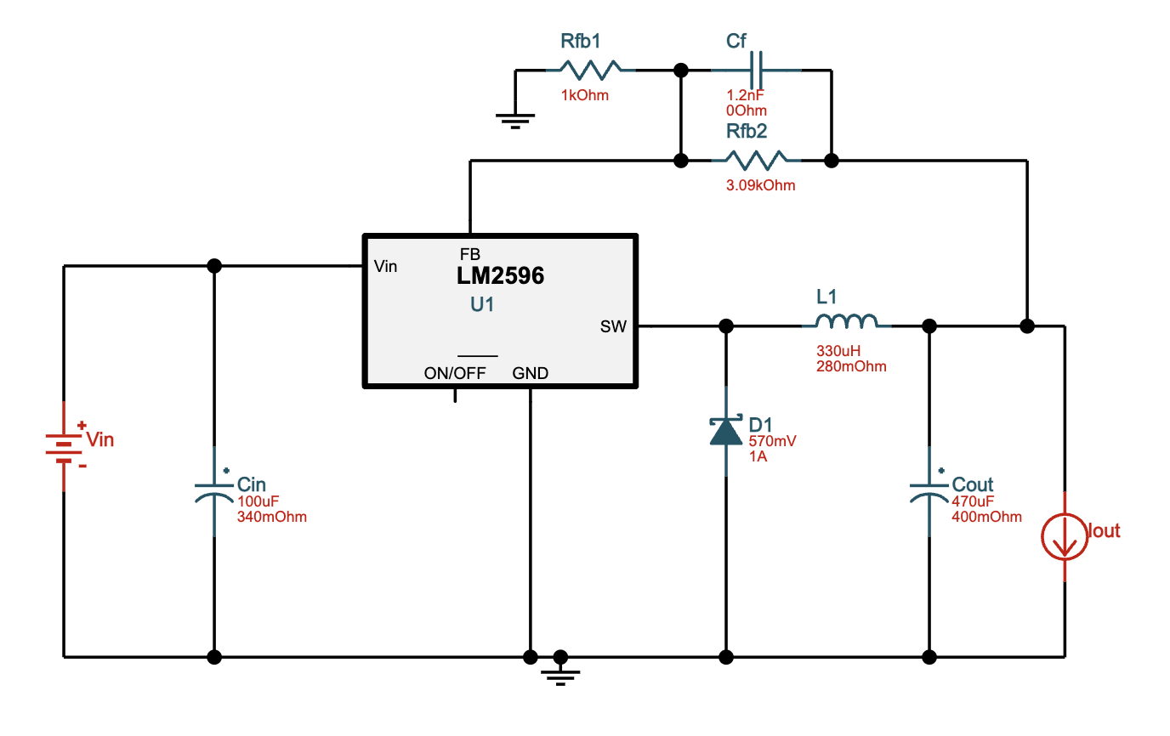
2. Buck DC-DC Converter
LM2596T-ADJ/NOPB ‑ 25V-30V to 5.00V @ 0.18A. 69.4% Efficiency

Slide 14
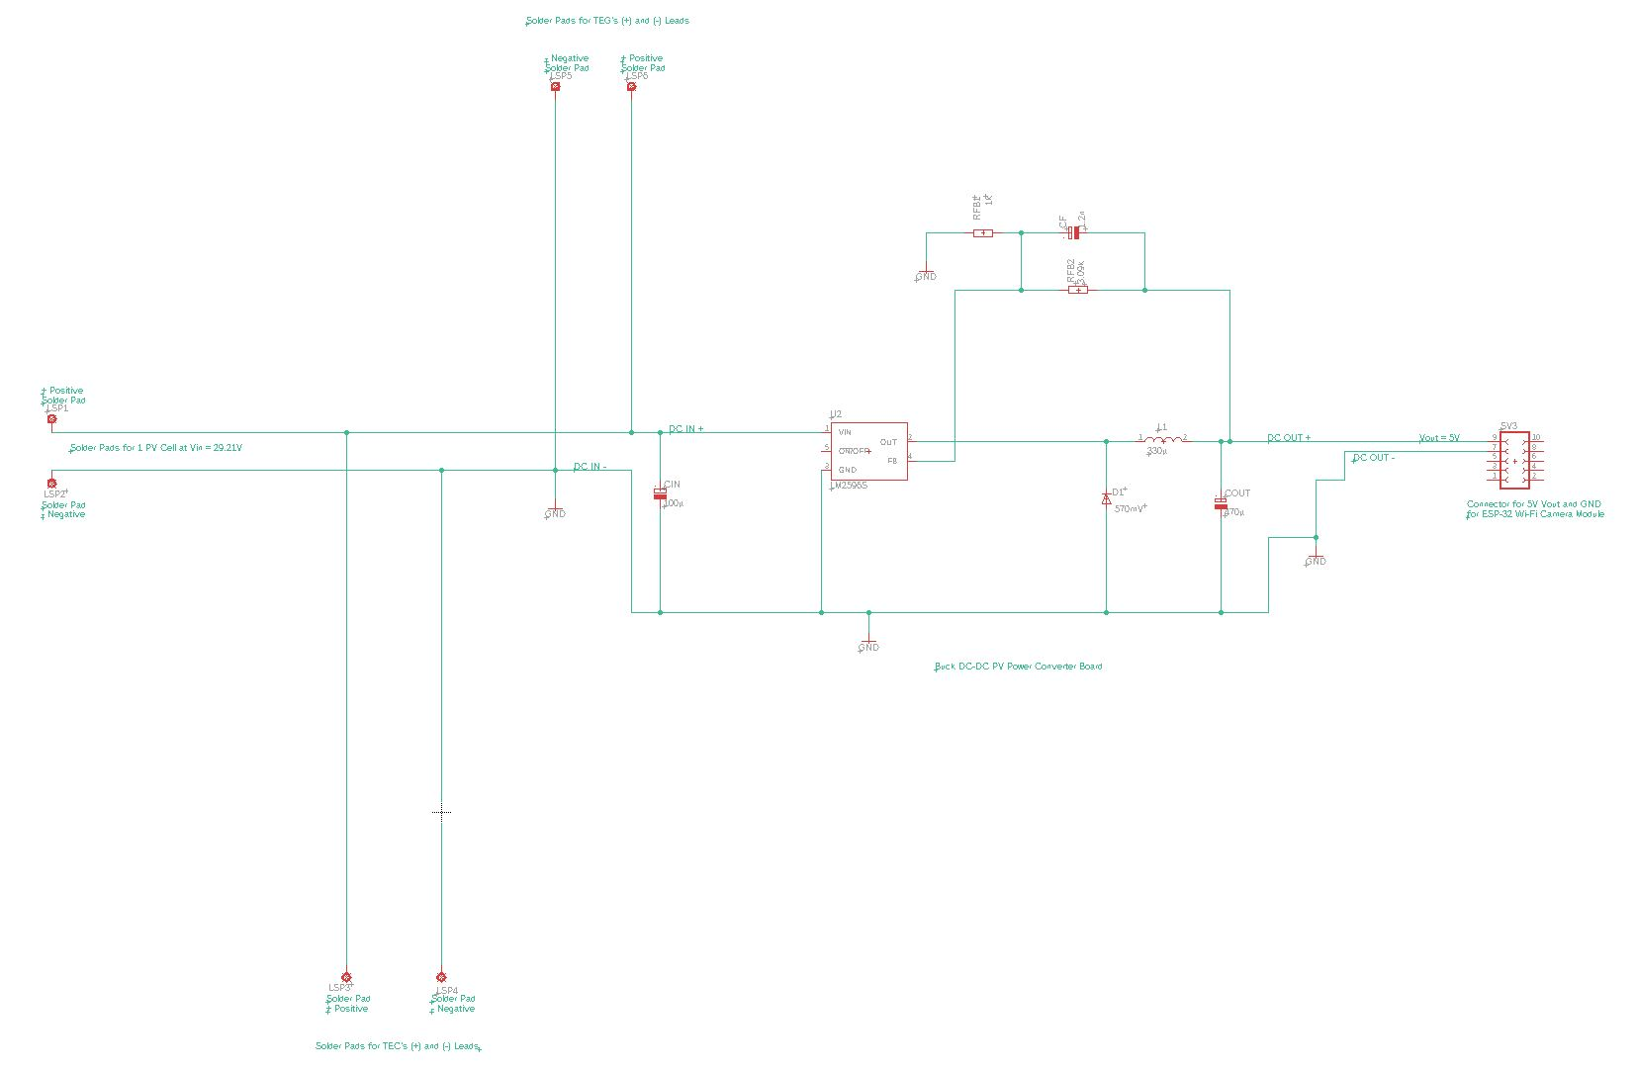
2.

Slide 15
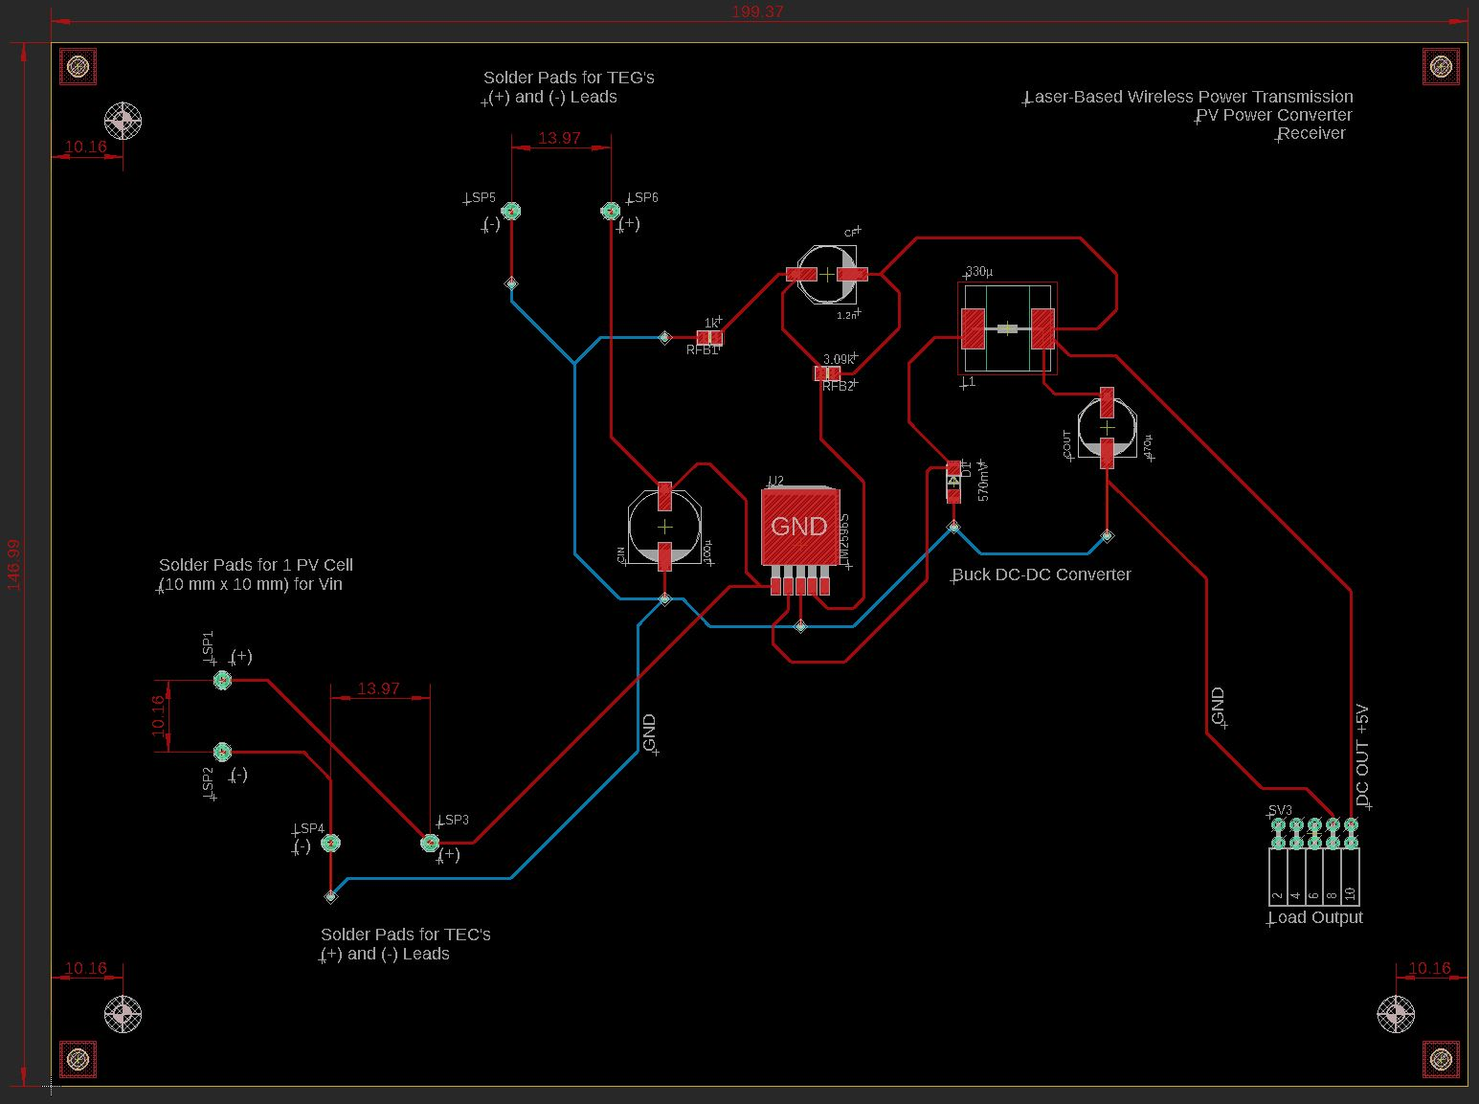
2.

Slide 16
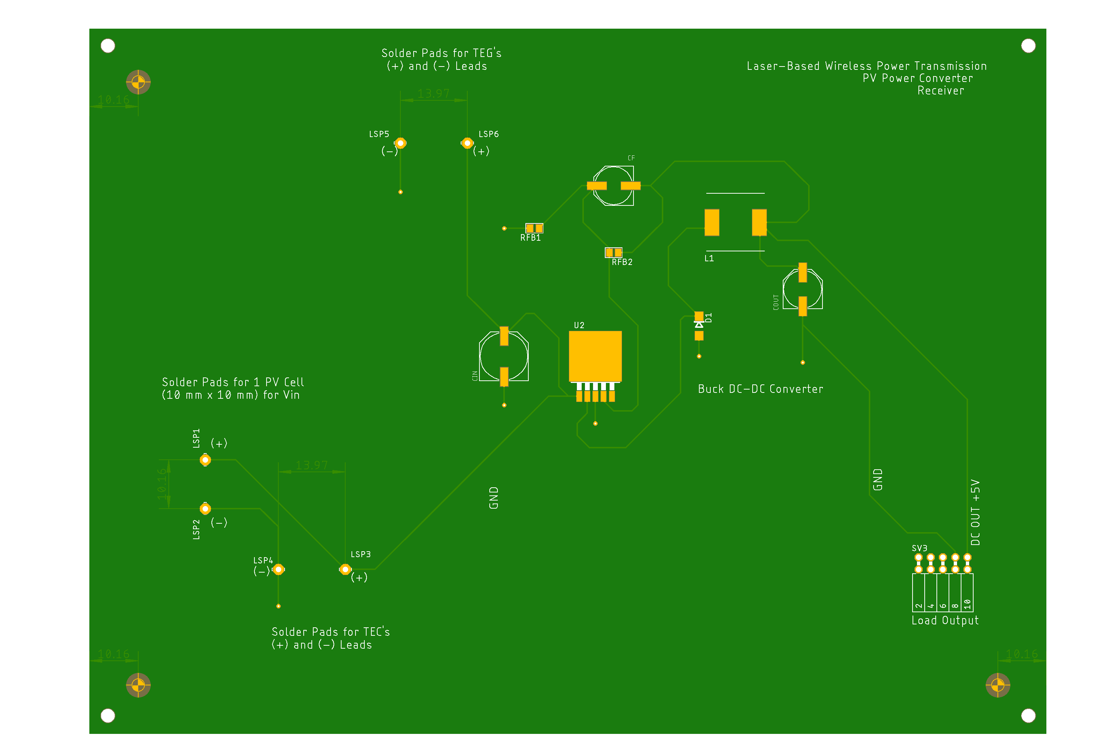
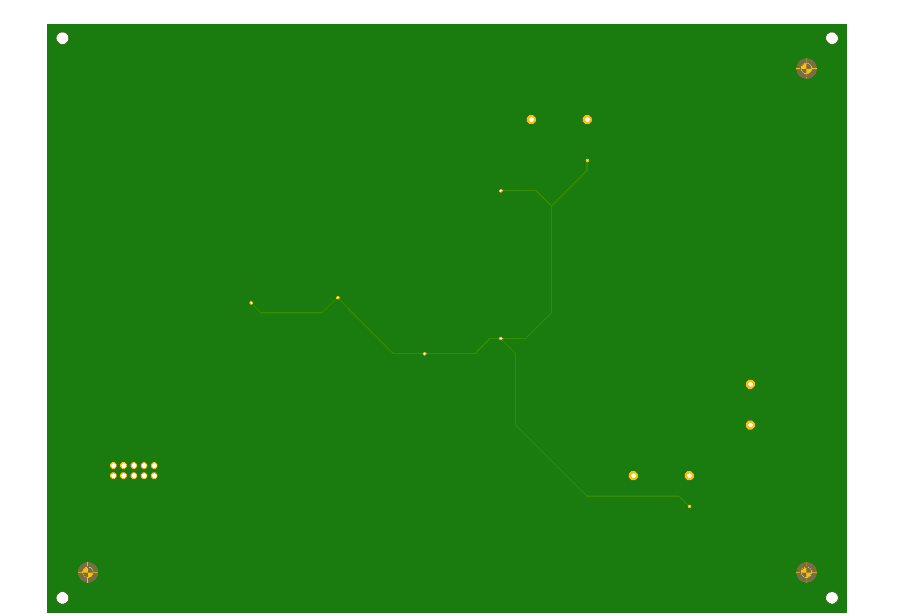
2.
Top
Bottom

Slide 17
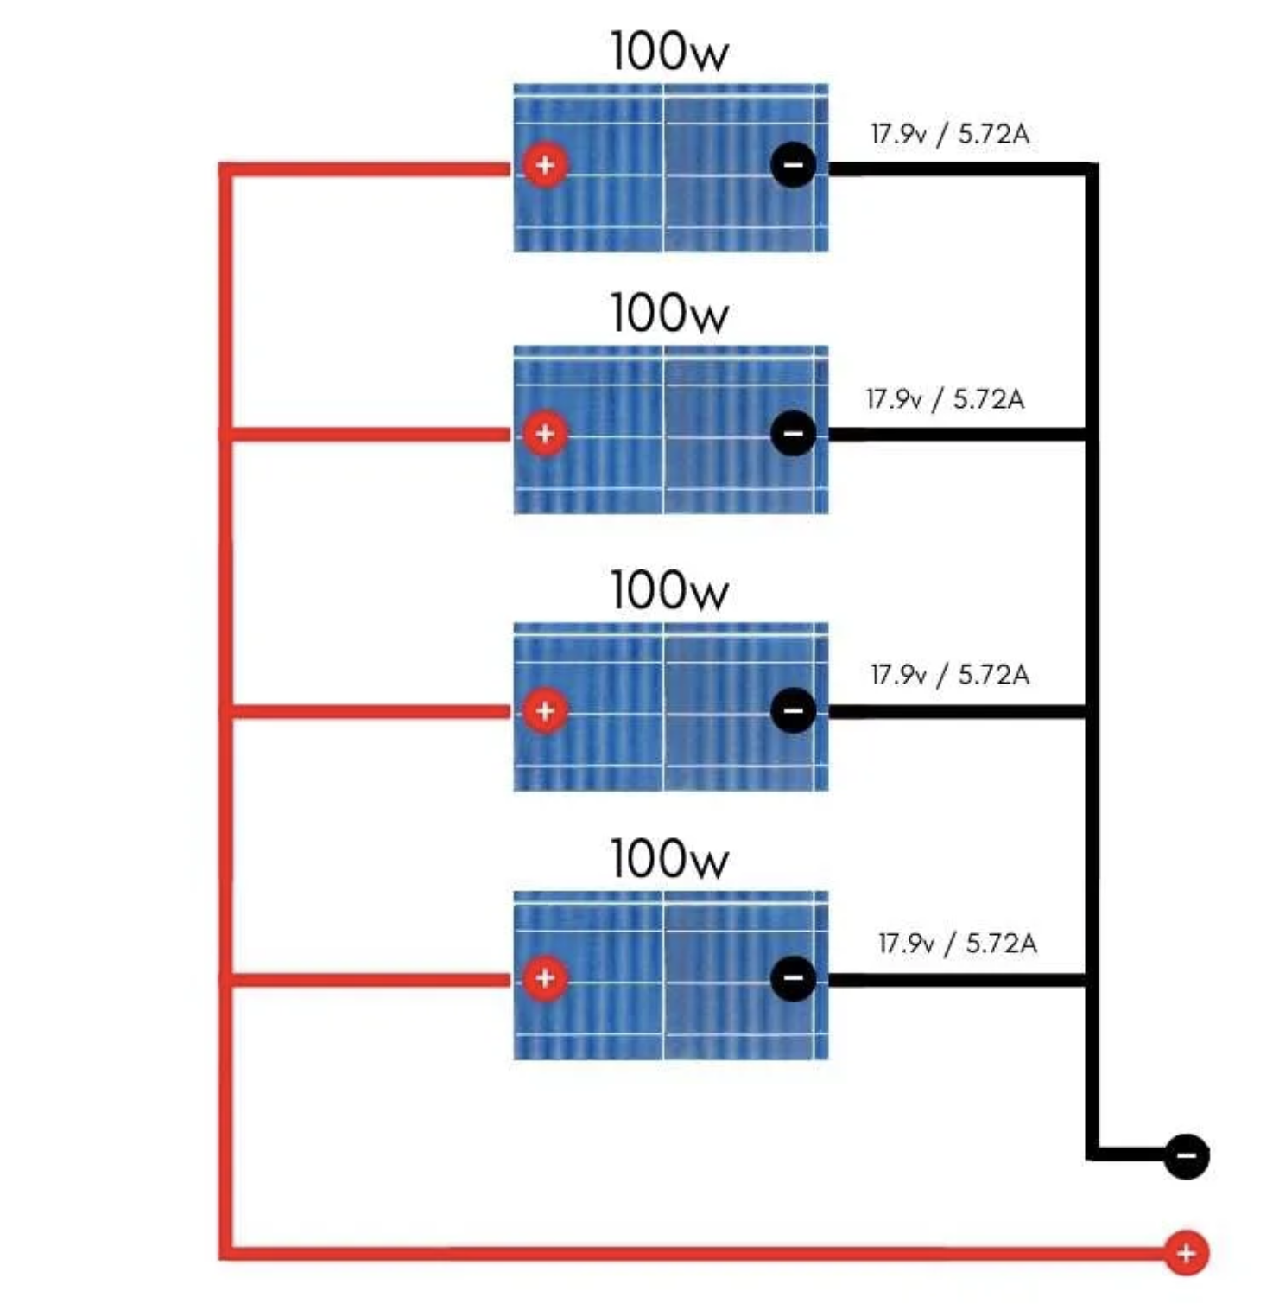
3. Design Specifications 1 cm x 1 cm MIH® VMJ PV Cell Form Factor, 4-PV, Parallel; Full Backplane Board
Peripherals:
Inputs:
PV Array: 2 leads (+ and -)
TEG module’s 2 leads (+ and -)
TEC module’s 2 leads (+ and -)
Outputs:
ESP-32 Wi-Fi camera
Internals:
Pads for soldered PV cells
PWM Control DSP, MCU, or FPGA for Switch Control
Buck DC-DC Converter circuit with Low-Pass Filter: 29.21 V to 5 V
- R, L, C, MOSFET Switch (Voltage-Controlled)
I/O Ports as Female Connectors
Voltage Requirements:
Input: 8 - 30 V:
Each PV cell has a 0.59267 W maximum power output
Each PV cell has a 29.21 V maximum voltage output
Total V_{out} = 29.21 V for a parallel connection
Total current = 0.02029 A x 4 PV cells = 0.08116 A for a parallel connection
Total power = 29.21 V x 0.08116 A = 2.3706836 W
Output: 5 V at 180 mA *or .18 A = 0.9 W
Miscellaneous:
Heat Sink

Slide 18
3. Buck DC-DC Converter
LM2596T-ADJ/NOPB ‑ 25V-30V to 5.00V @ 0.18A. 69.4% Efficiency

Slide 19
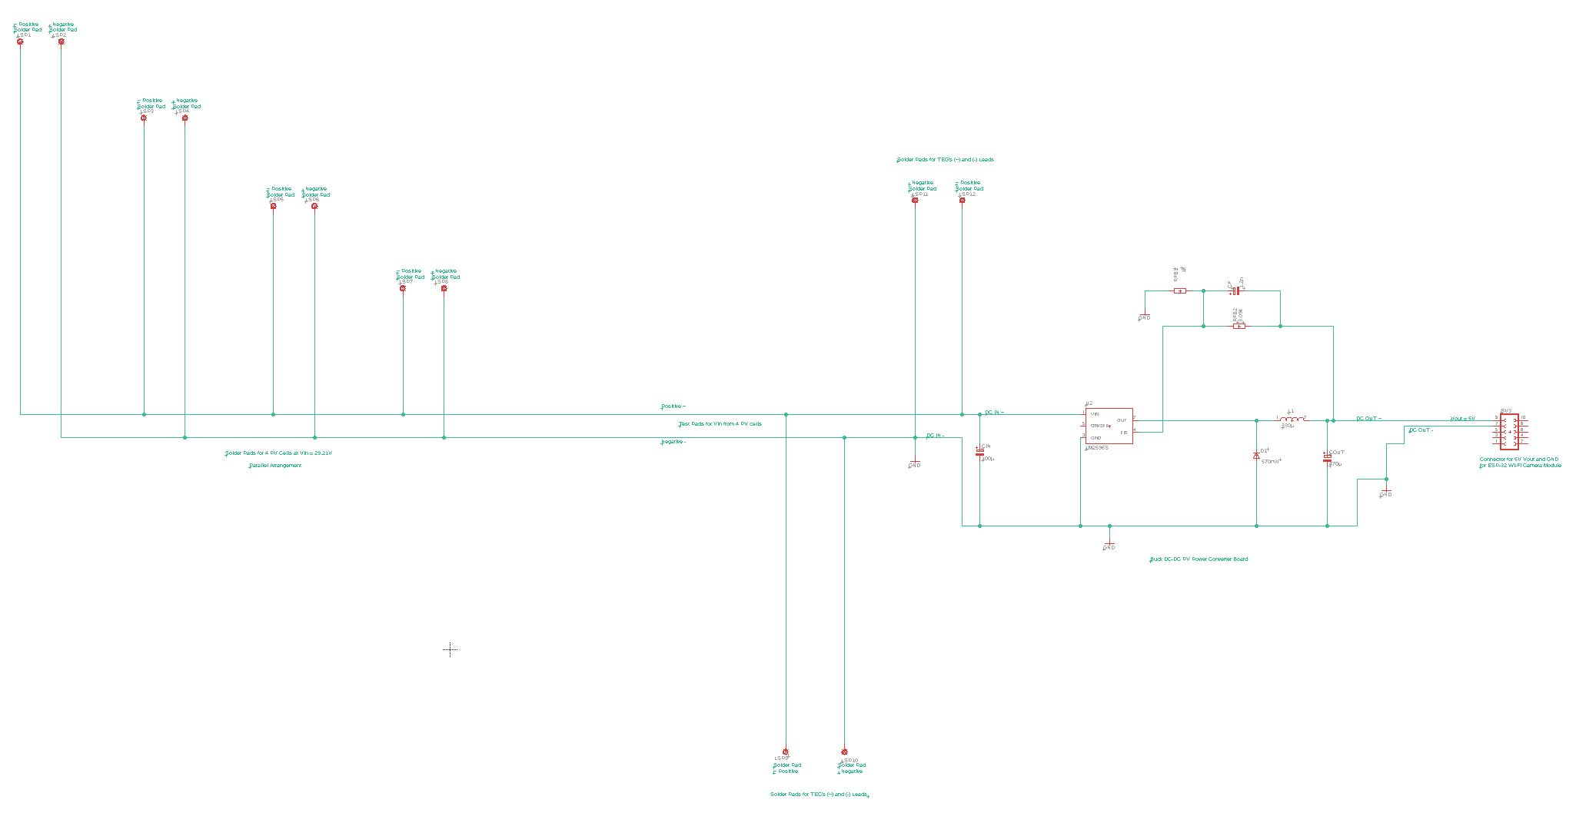
3.

Slide 20
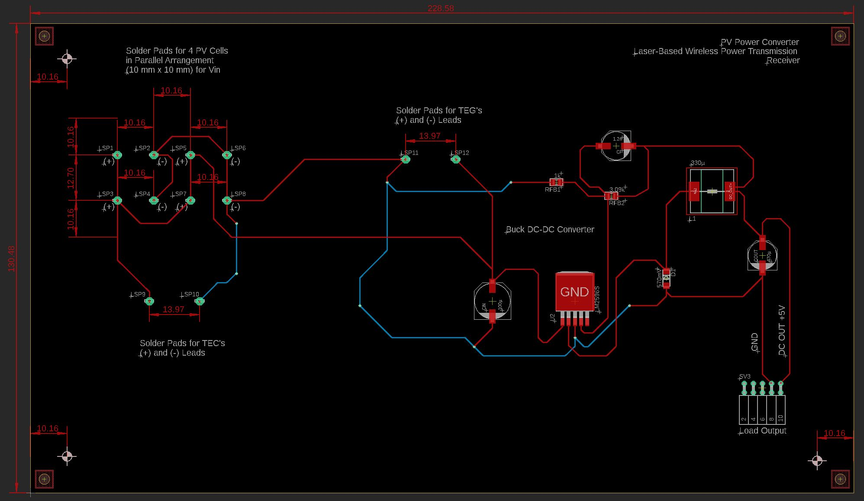
3.

Slide 21
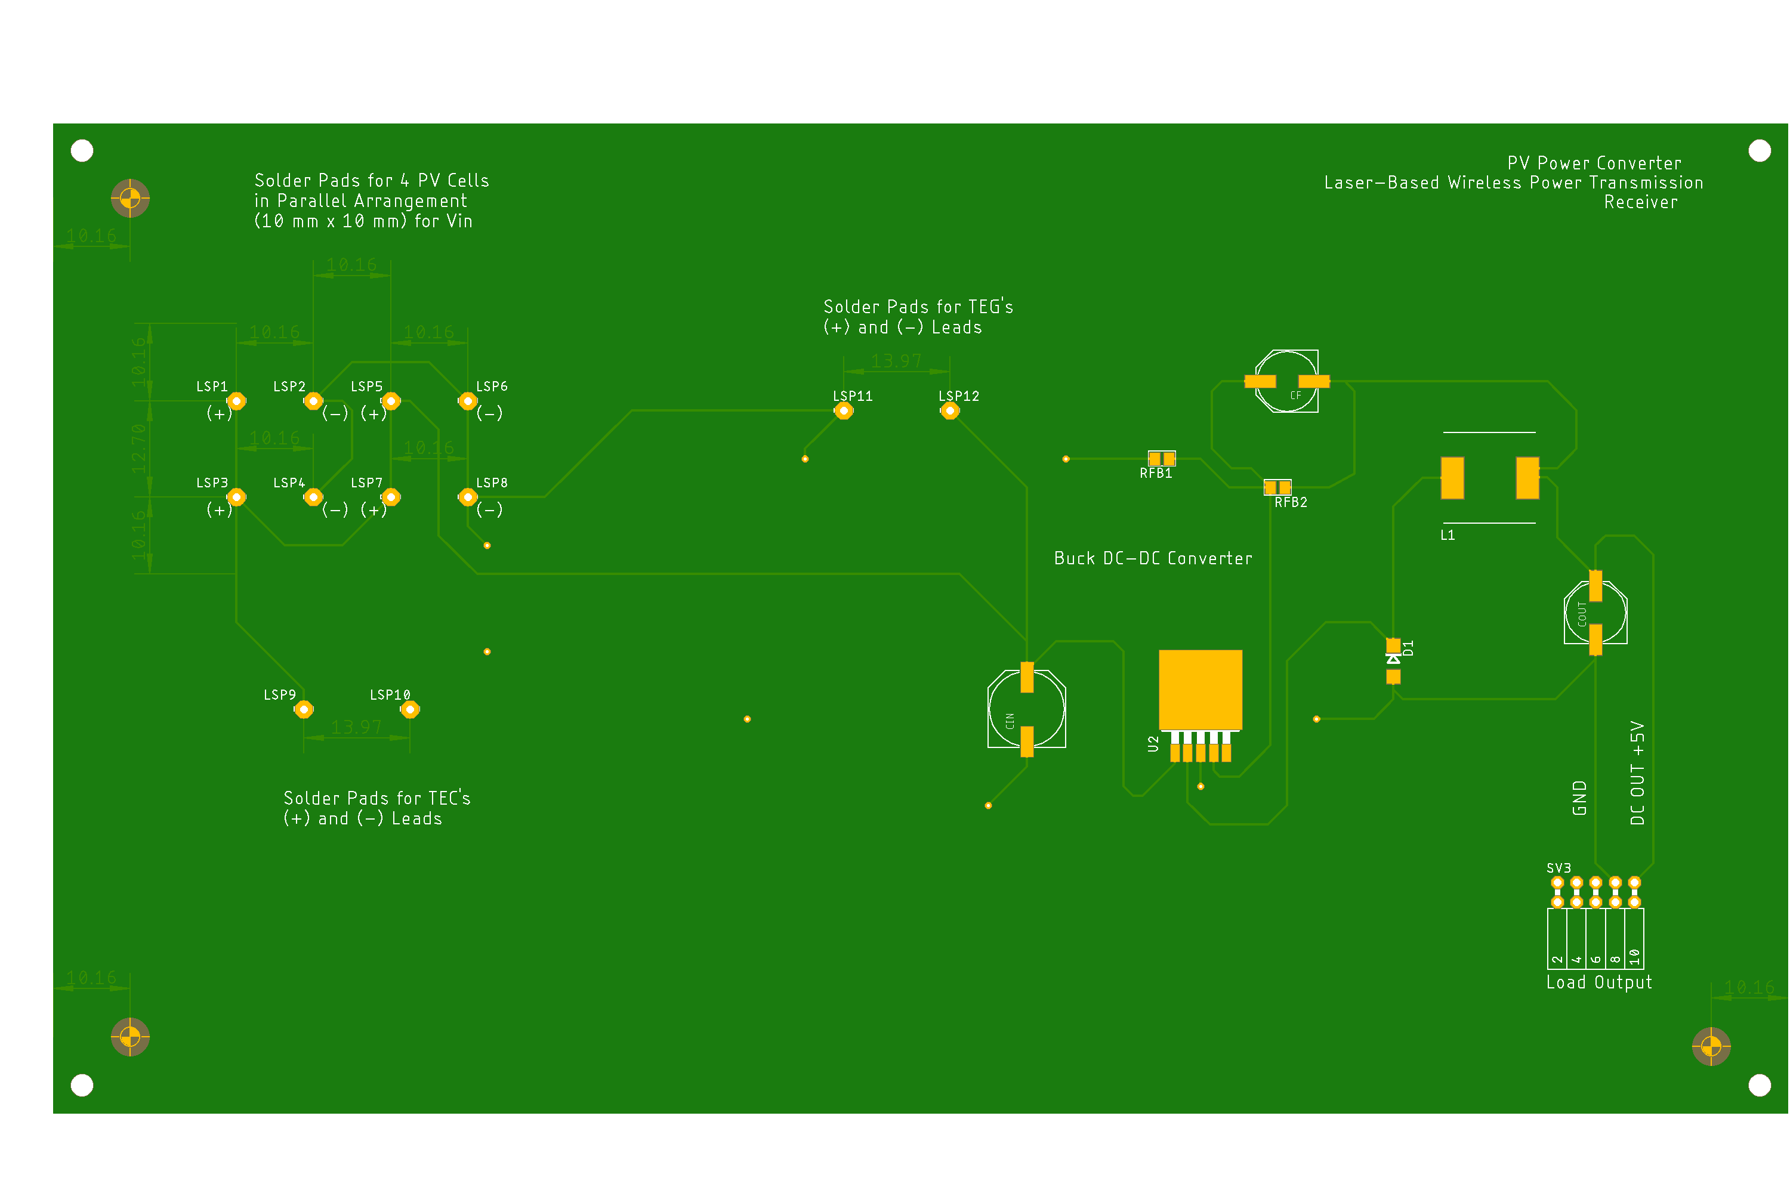
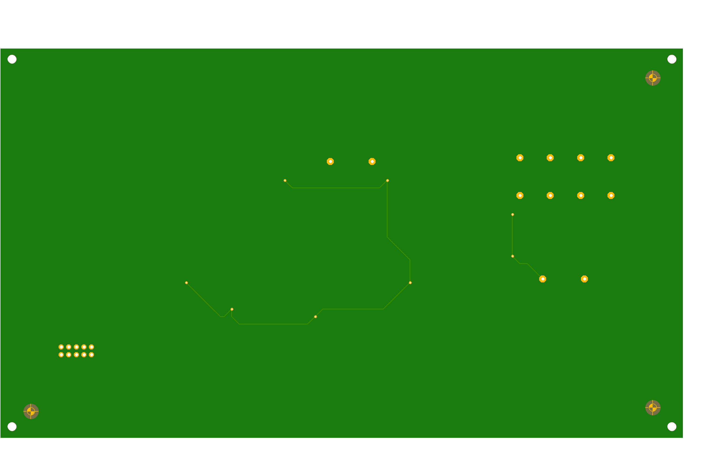
3.
Top
Bottom

Slide 22
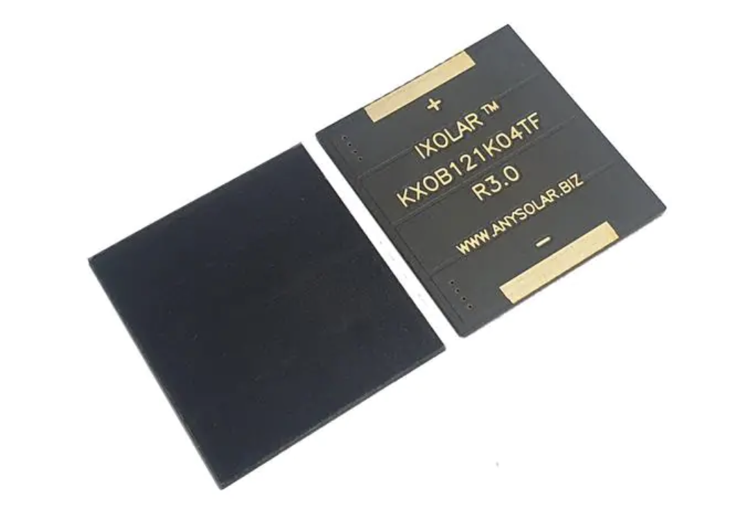
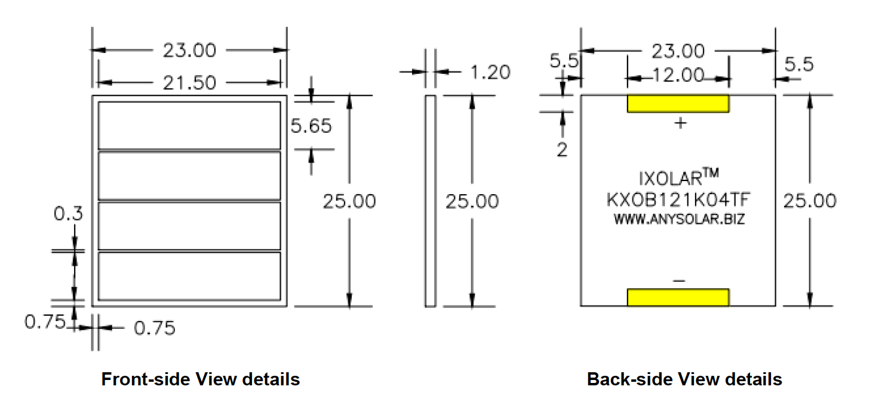
4. Design Specifications, 2.5 cm x 2.5 cm PV Cell Form Factor, 4-PV, Parallel; Extension Board: Configurable for Externally Adaptive Load Circuitry
Peripherals:
Inputs:
PV Array: 2 leads (+ and -) x 4 PV cells = 8 leads
TEG module’s 2 leads (+ and -)
TEC module’s 2 leads (+ and -)
Outputs:
ESP-32 Wi-Fi camera
Internals:
Pads for soldered PV cells
I/O Ports as Female Connectors
Voltage Requirements:
Input:
Each PV cell has a 0.0472 A current output at P_{mpp}
Each PV cell has a 2.23 V voltage output at P_{mpp}
Each PV cell has a 0.1053 W maximum power output
Output: 5 V at 180 mA or 0.18 A = 0.9 W
Miscellaneous:
Heat Sink
*Required Separately: Boost DC-DC Converter circuit: 2.23 V to 5 V

Slide 23
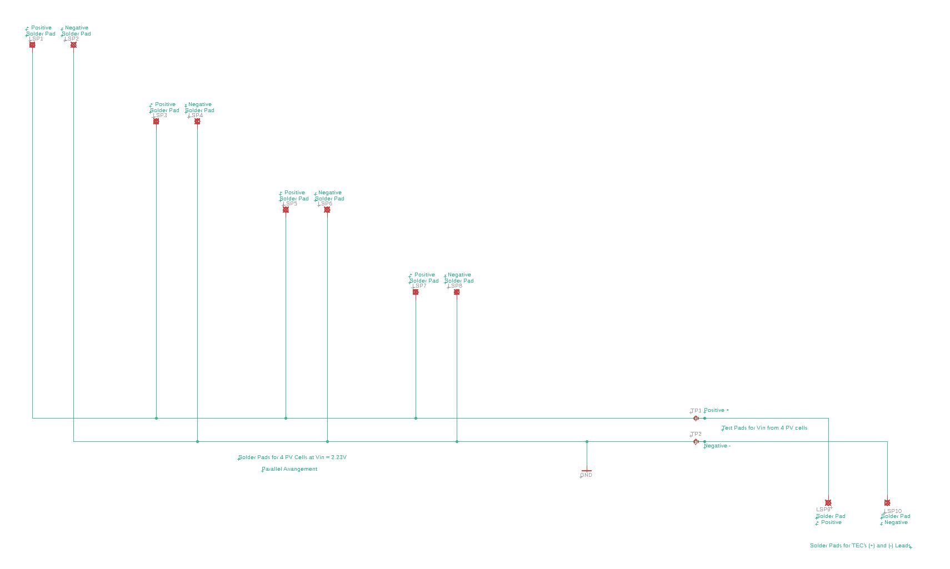
4.

Slide 24
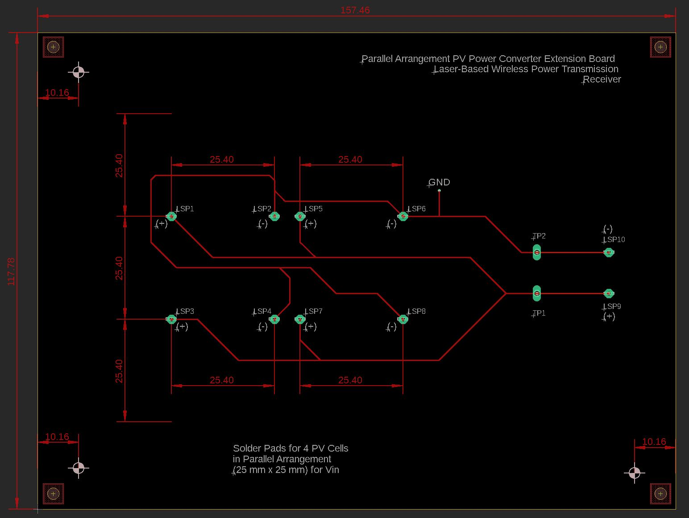
4.

Slide 25
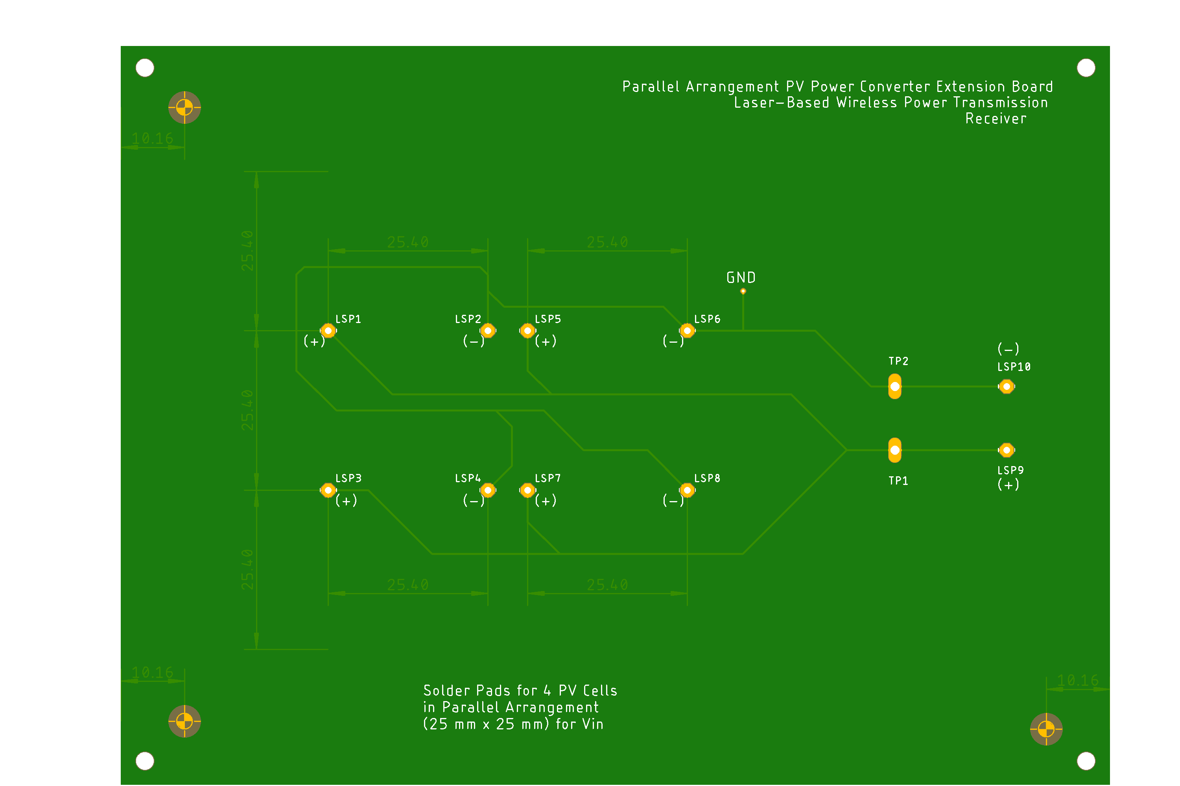
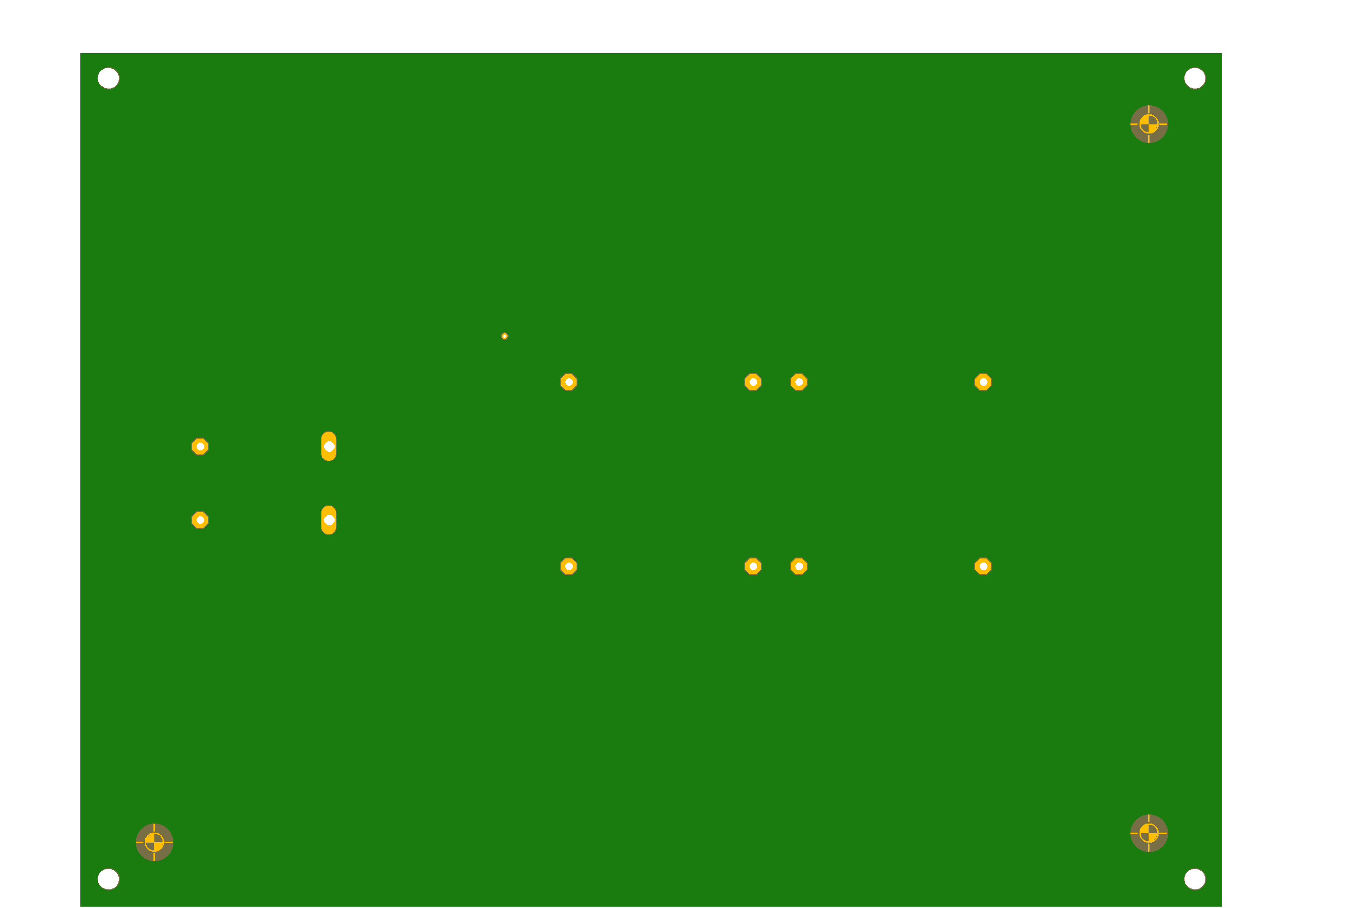
4.
Top
Bottom

Slide 26
5. Design Specifications, 2.5 cm x 2.5 cm PV Cell Form Factor, 4-PV, Series; Full Backplane Board
Peripherals:
Inputs:
PV Array: 2 leads (+ and -) leads
TEG module’s 2 leads (+ and -)
TEC module’s 2 leads (+ and -)
Outputs:
ESP-32 Wi-Fi camera
Internals:
Pads for soldered PV cells
PWM Control DSP, MCU, or FPGA for Switch Control
Buck DC-DC Converter circuit with Low-Pass Filter: 8.92 V to 5 V
- R, L, C, MOSFET Switch (Voltage-Controlled)
I/O Ports as Female Connectors
Voltage Requirements:
Input: 8 - 30 V:
Each PV cell has a 0.1053 W maximum power output
Each PV cell has a 2.23 V voltage output at Pmpp
Total V_{out} = 2.23 V x 4 PV cells; Voltage output = 8.92 V for a series connection
Total current = 0.0472 A current output at Pmpp for a series connection
Output: 5 V at 180 mA or 0.18 A = 0.9 W
Miscellaneous:
Heat Sink

Slide 27
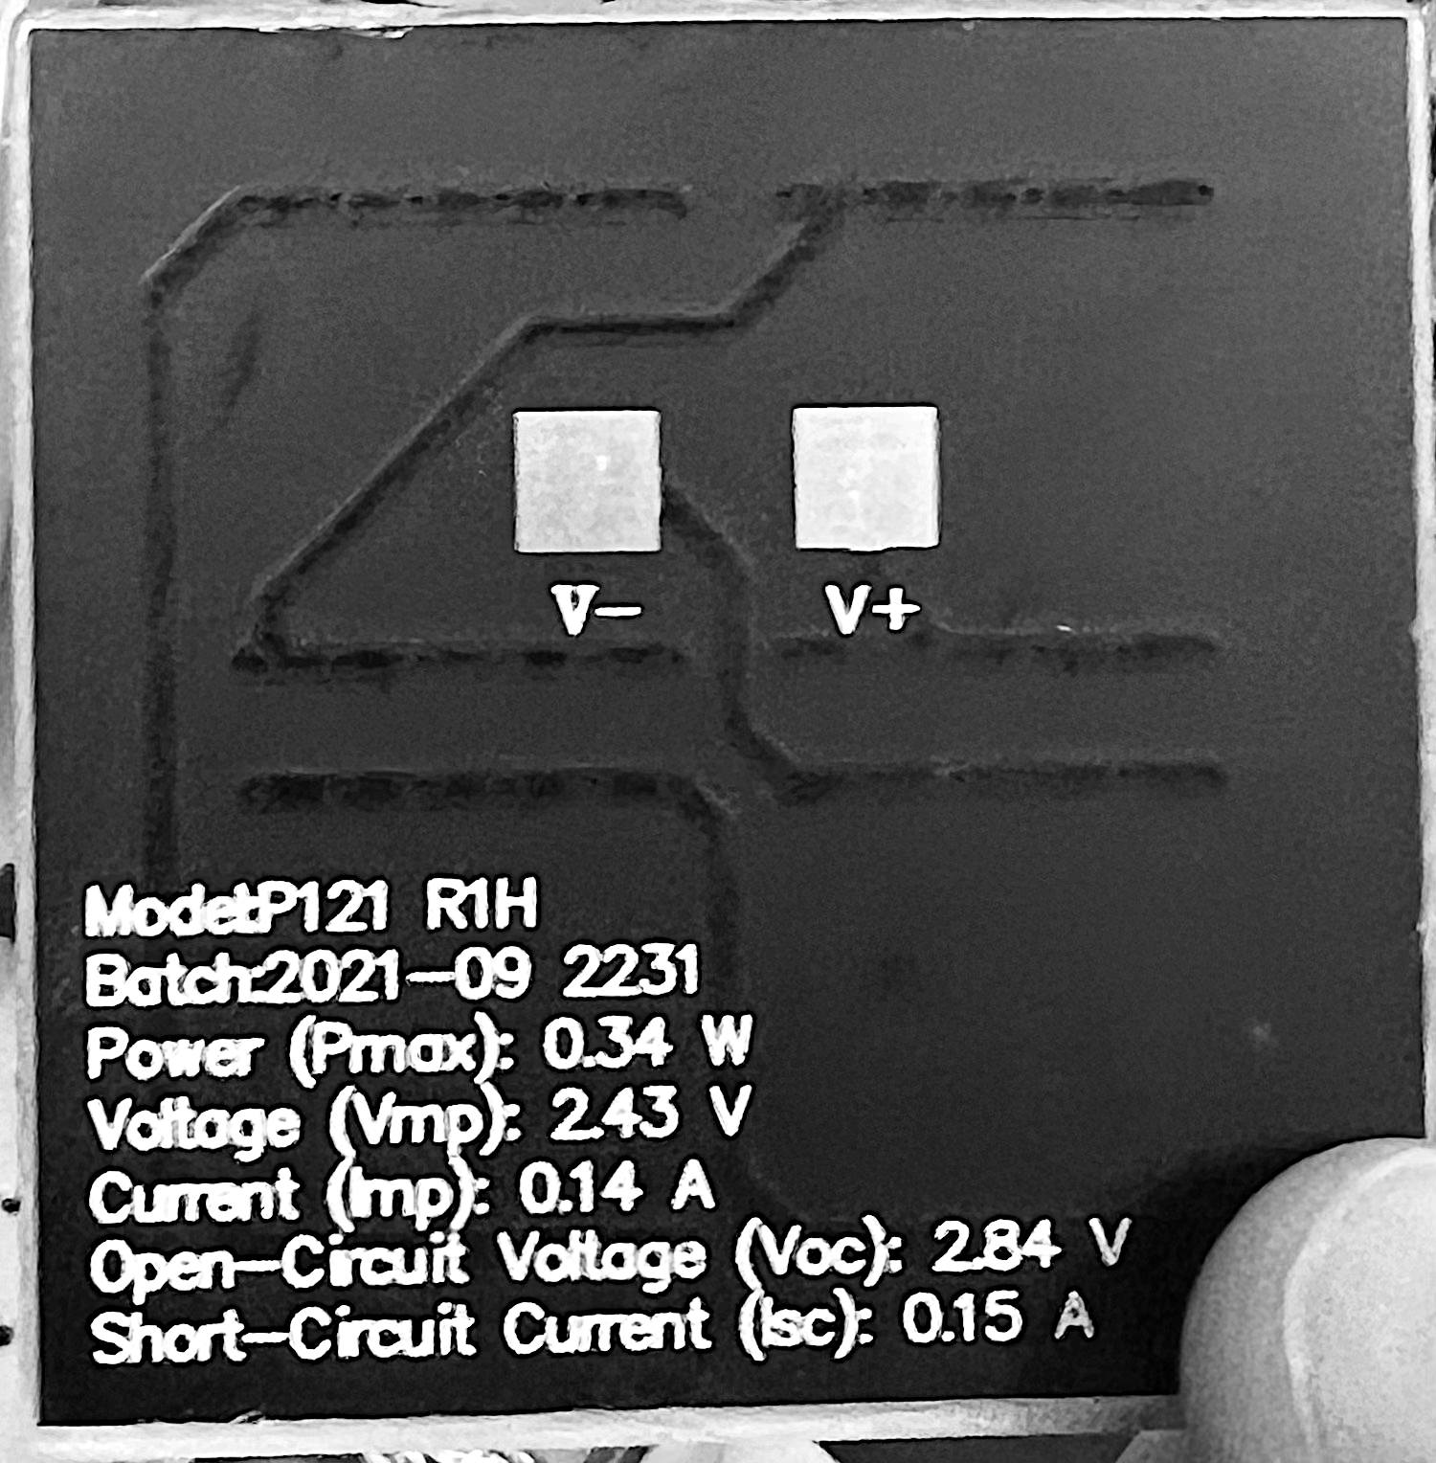
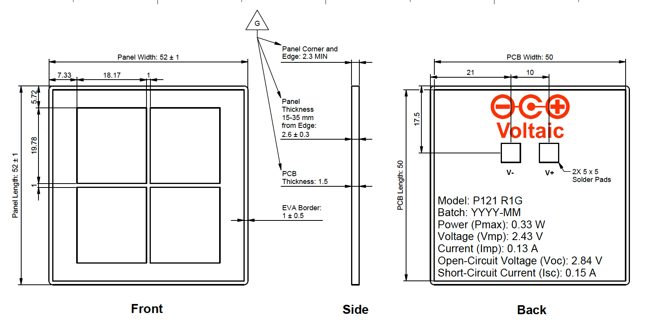
6. Design Specifications, 5 cm x 5 cm PV Cell Form Factor, 4-PV, Series; Full Backplane Board
Peripherals:
Inputs:
PV Array: 2 leads (+ and -) leads
TEG module’s 2 leads (+ and -)
TEC
Outputs:
ESP-32 Wi-Fi camera
Internals:
Pads for soldered PV cells
PWM Control DSP, MCU, or FPGA for Switch Control
Buck DC-DC Converter circuit with Low-Pass Filter: 9.72 V to 5 V
- R, L, C, MOSFET Switch (Voltage-Controlled)
I/O Ports as Female Connectors
Voltage Requirements:
Input: 8 - 30 V:
Each PV cell has a 0.34 W power output
Each PV cell has a 2.43 V voltage output
Total V_{out} = 2.43 V x 4 PV cells; Voltage output = 9.72 V for a series connection
Total current = 0.14 A for a series connection
Output: 5 V at 180 mA or 0.18 A = 0.9 W
Miscellaneous:
Heat Sink

Slide 28
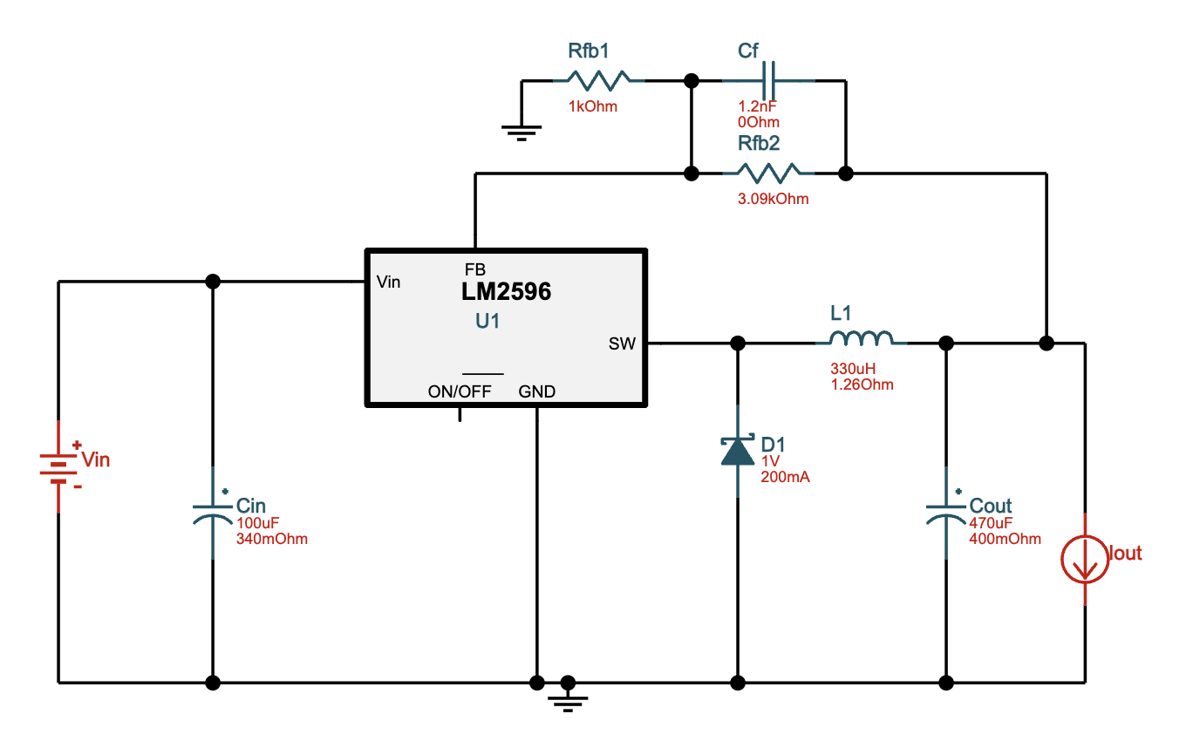
5 & 6. Buck DC-DC Converter
LM2596T-ADJ/NOPB ‑ 8V-30V to 5.00V @ 0.18A. 68.8% Efficiency

Slide 29
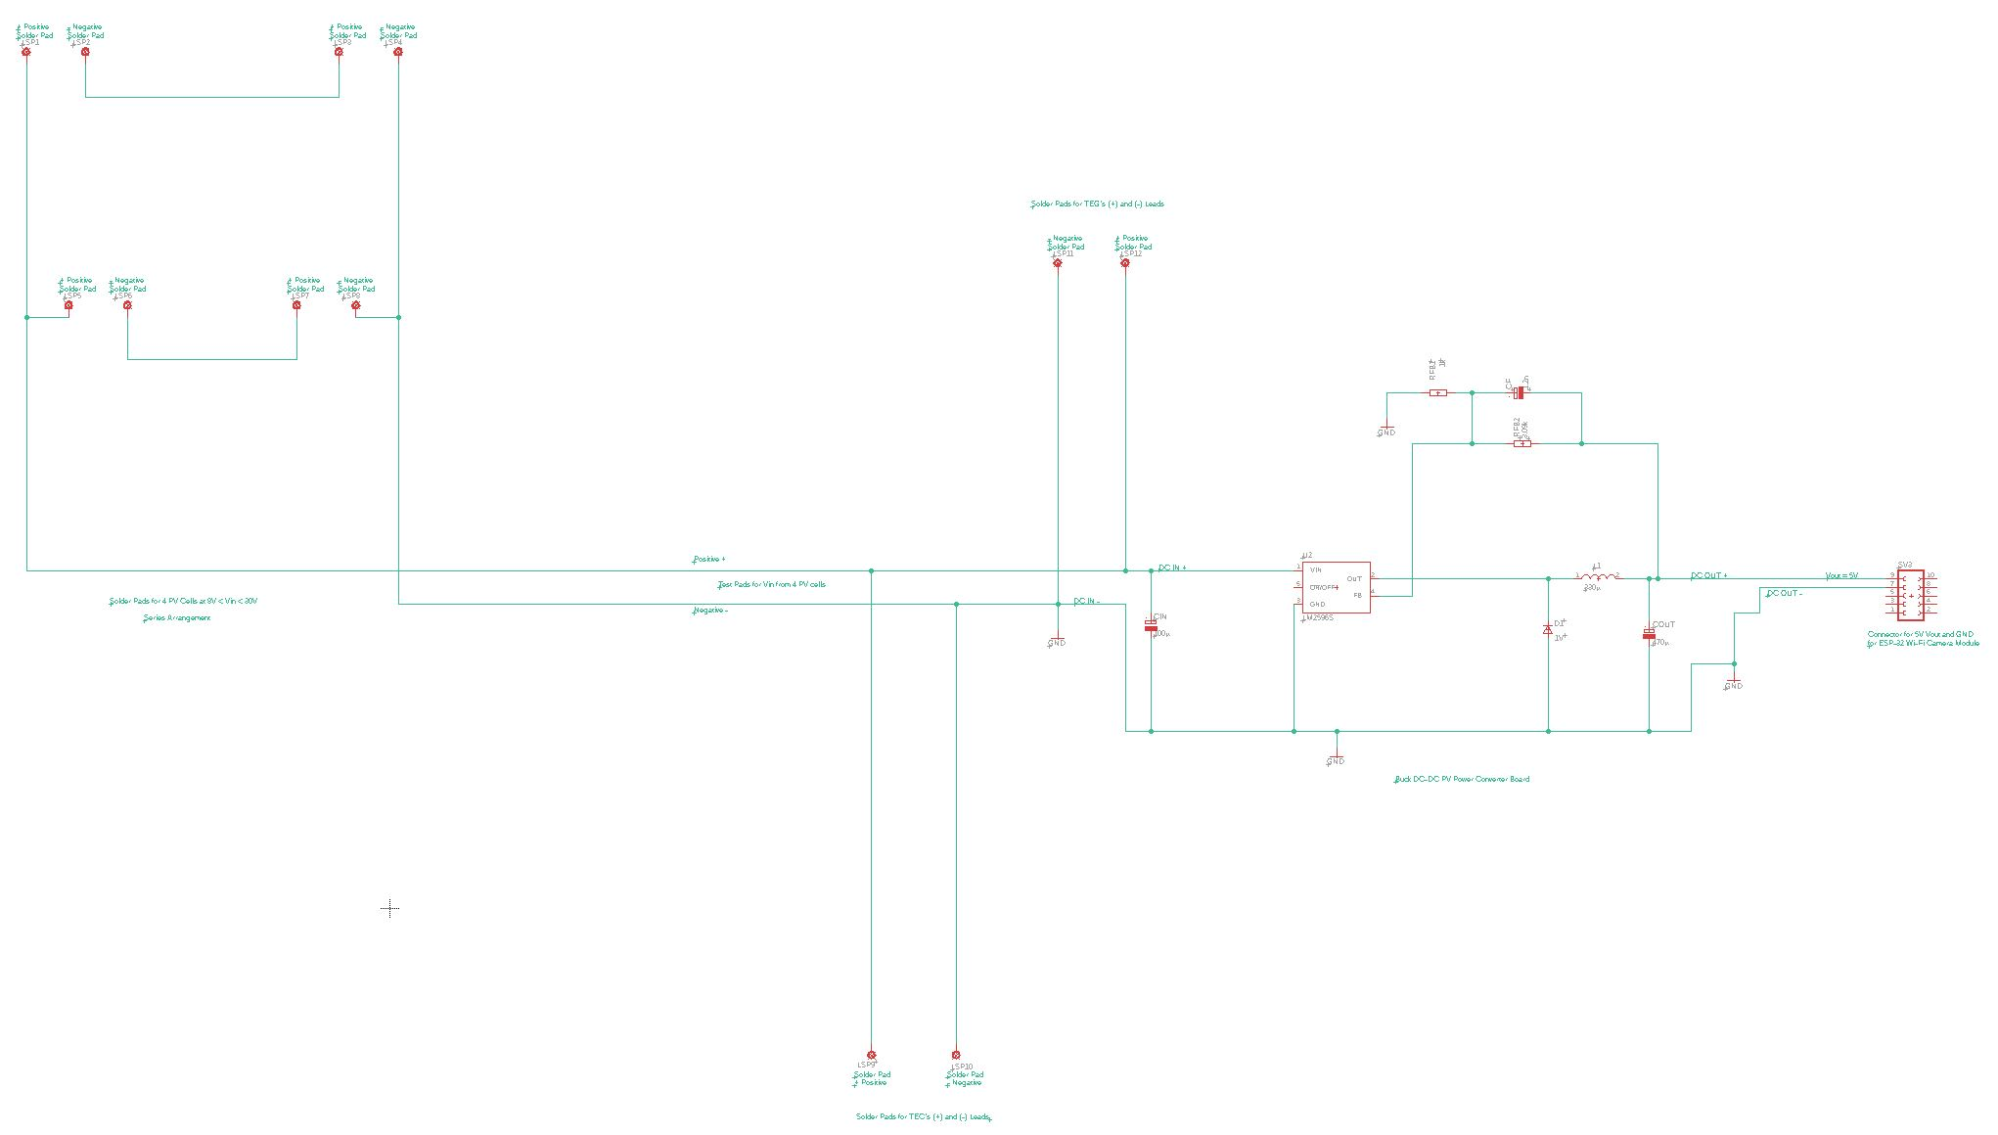
5 & 6.

Slide 30
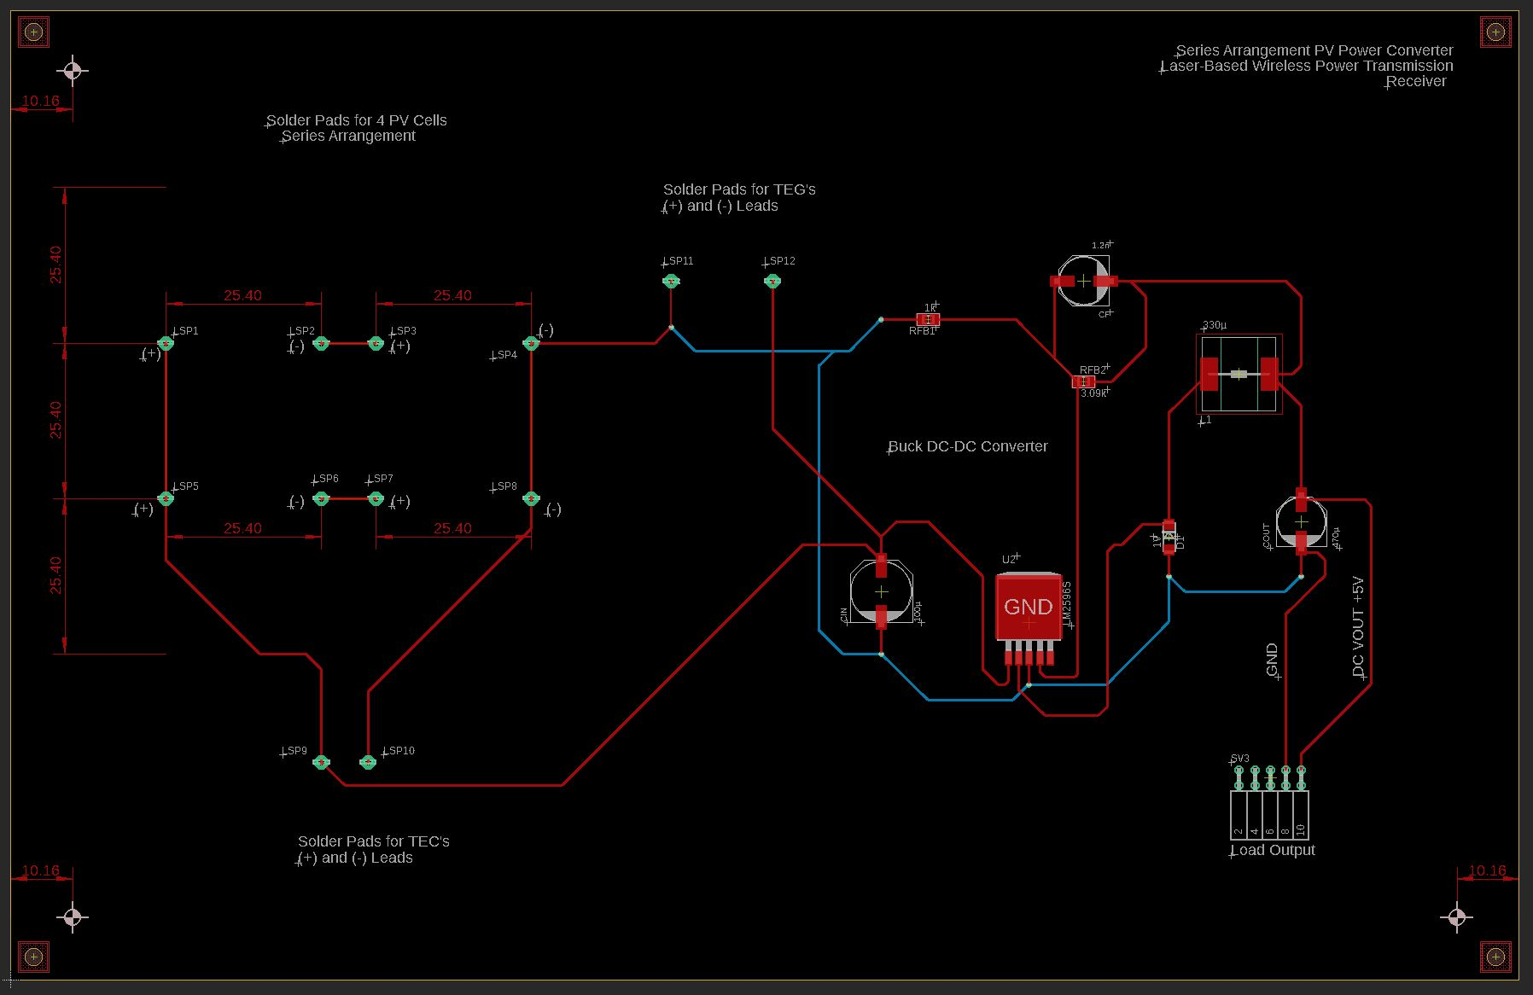
5.

Slide 31
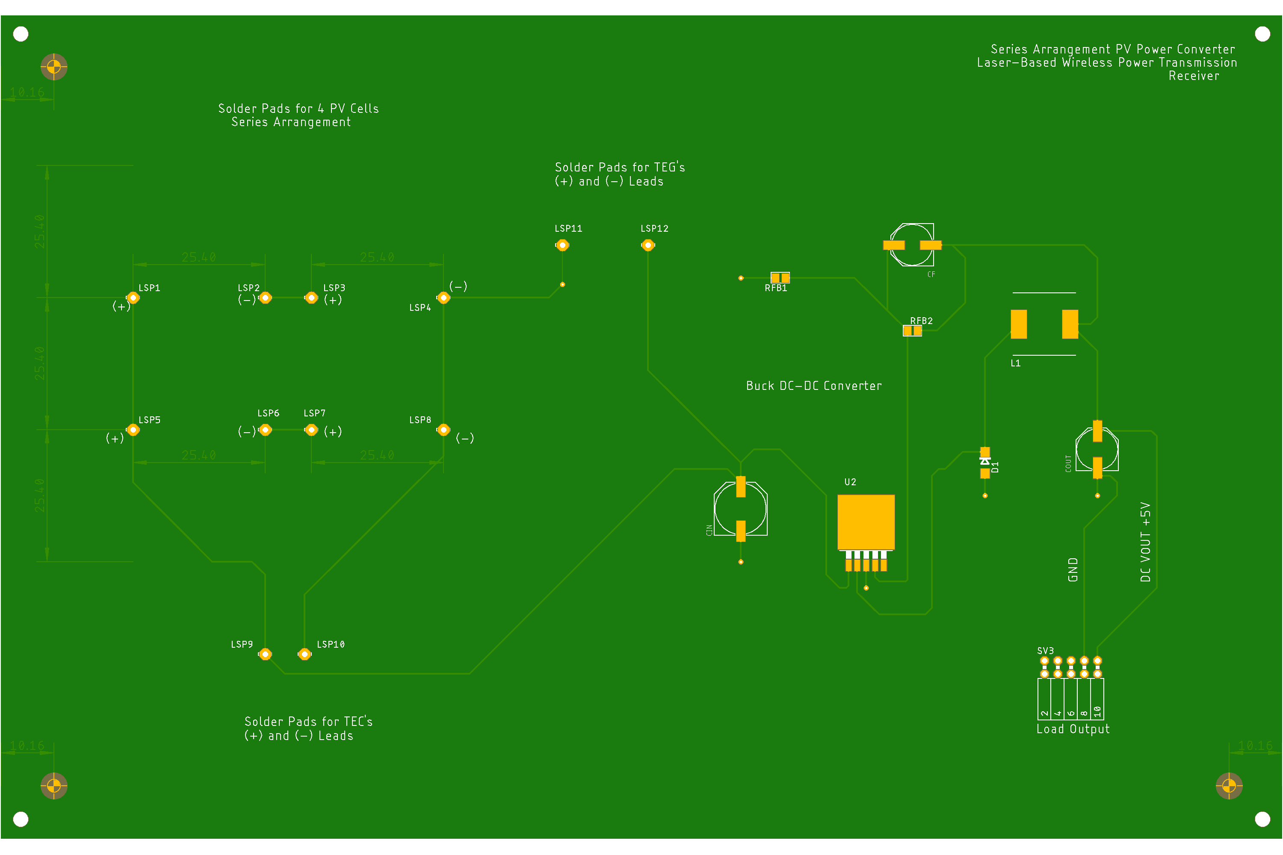
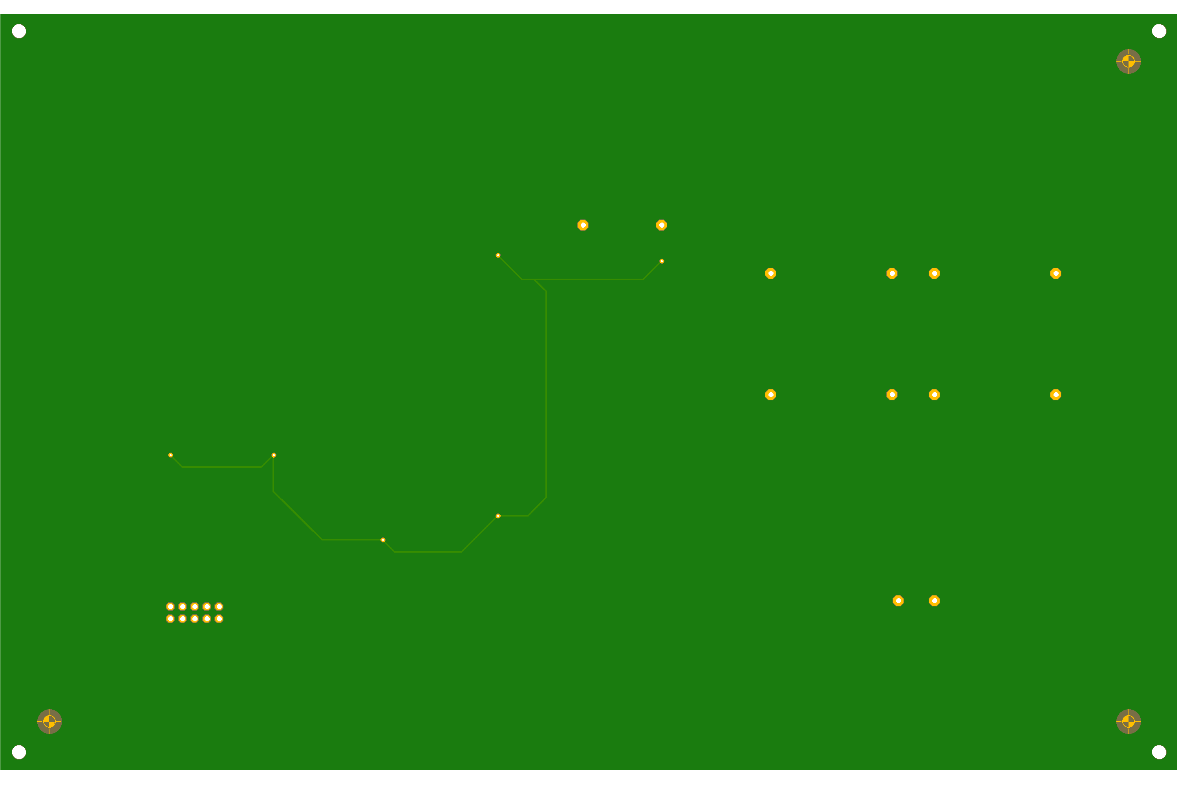
5.
Top
Bottom

Slide 32
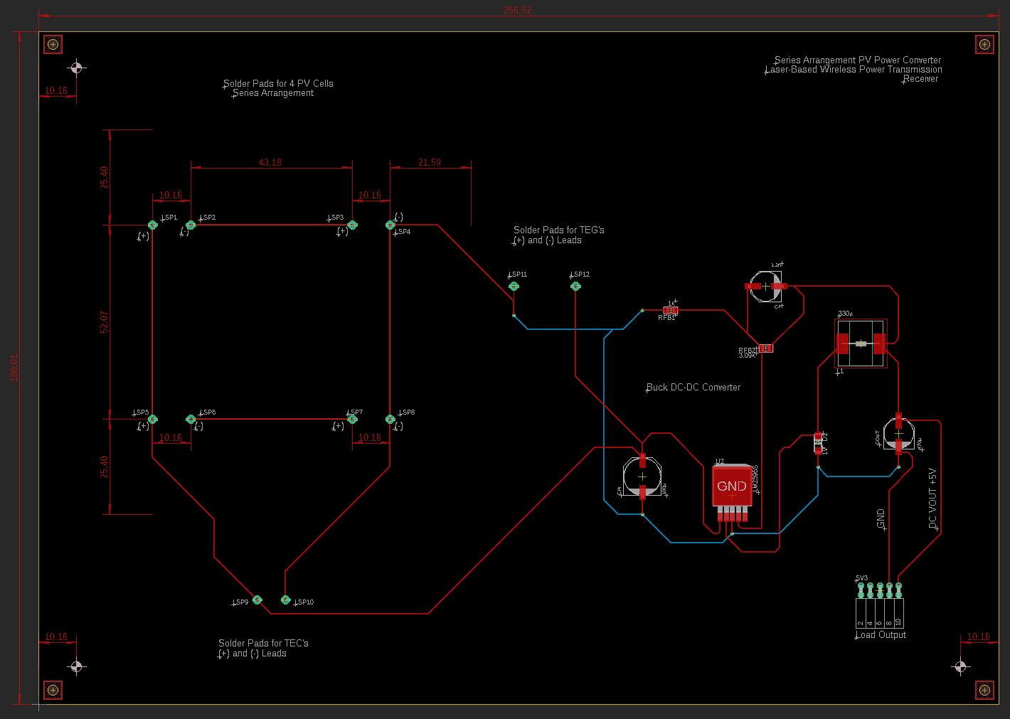
6.

Slide 33
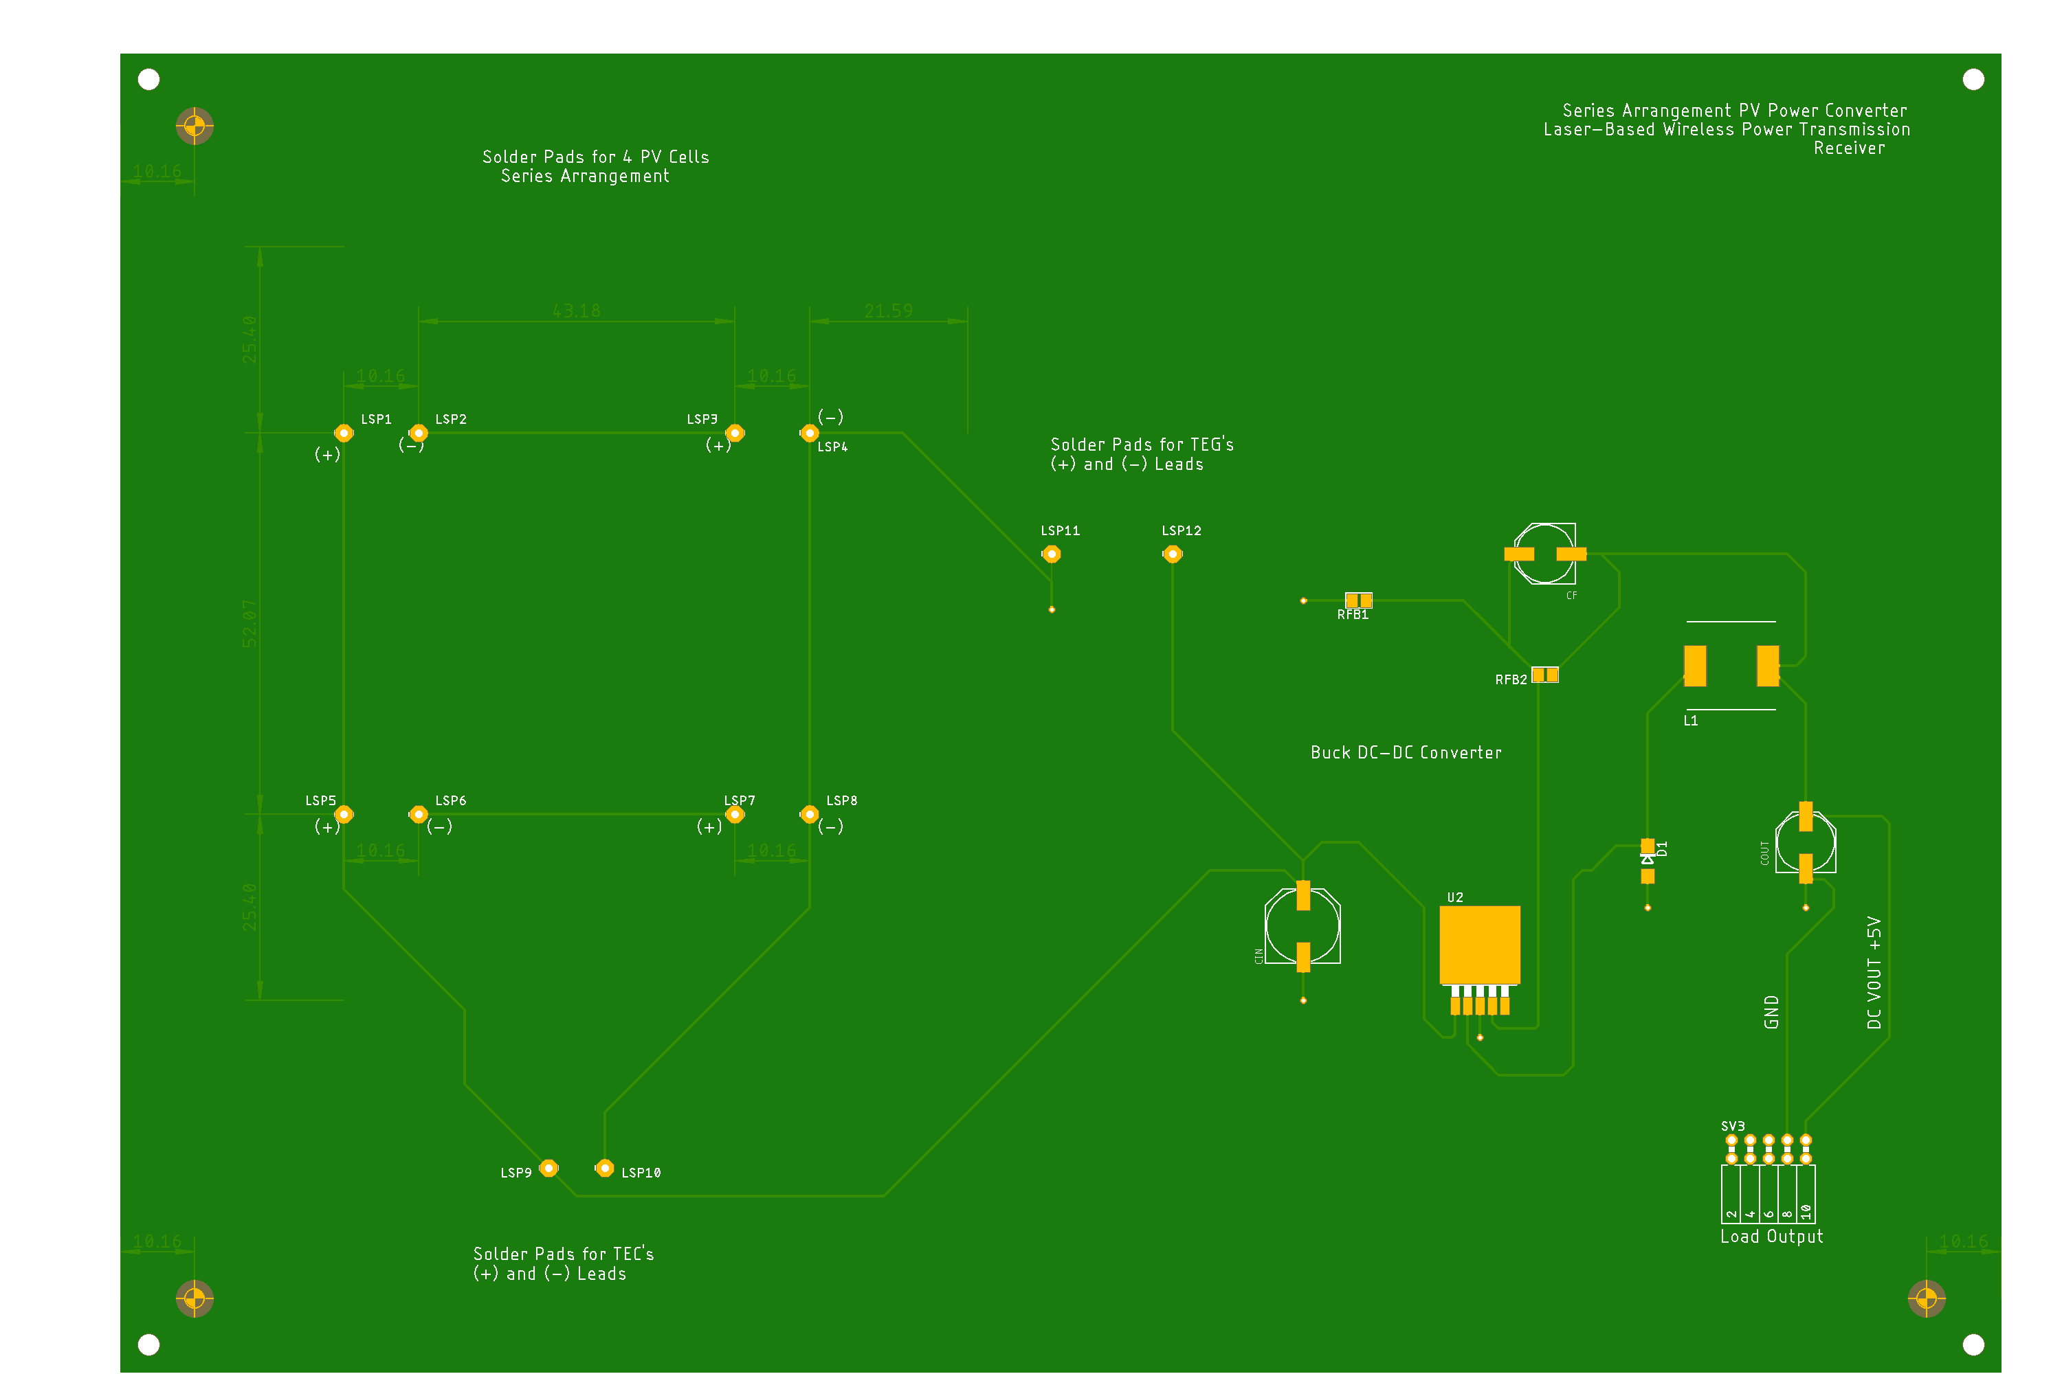
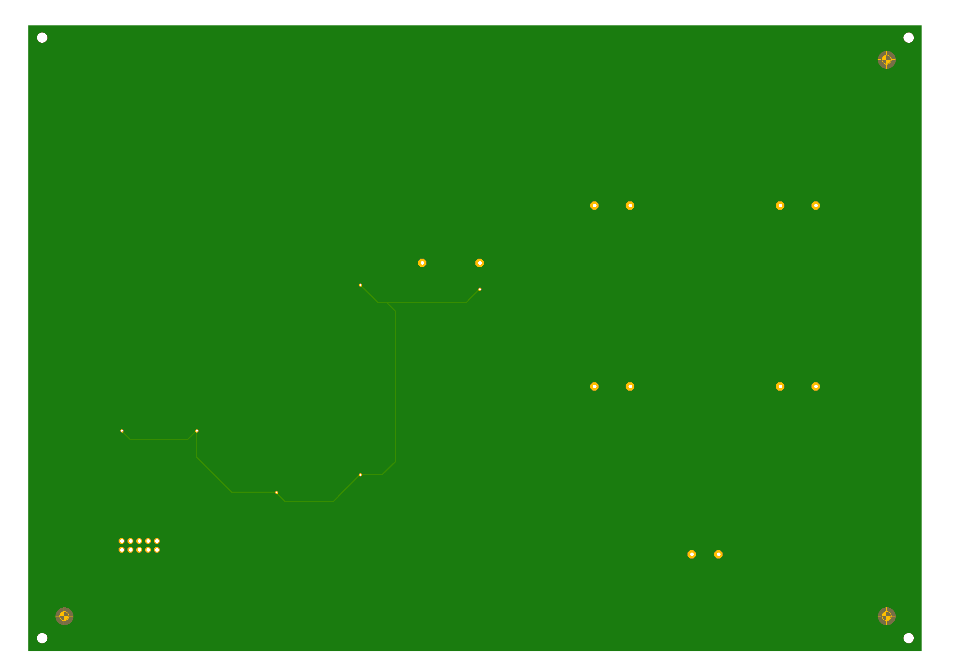
6.
Top
Bottom

Slide 34
7. Design Specifications, 5 cm x 5 cm PV Cell Form Factor, 4-PV, Series; Backplane Extension Board
Peripherals:
Inputs:
PV Array: 2 leads (+ and -) x 4 PV cells = 8 leads
TEG module’s 2 leads (+ and -)
TEC module’s 2 leads (+ and -)
Outputs:
ESP-32 Wi-Fi camera
Internals:
Pads for soldered PV cells
I/O Ports as Female Connectors
Voltage Requirements:
Input: 8 - 30 V:
Each PV cell has a 0.34 W power output
Each PV cell has a 2.43 V
Total V_{out} = 2.43 V x 4 PV cells; Voltage output = 9.72 V for a series connection
Total current = 0.14 A for a series connection
Output: 5 V at 180 mA or 0.18 A = 0.9 W
Miscellaneous:
Heat Sink
*Required Separately: Buck DC-DC Converter circuit: 9.72 V to 5 V

Slide 35
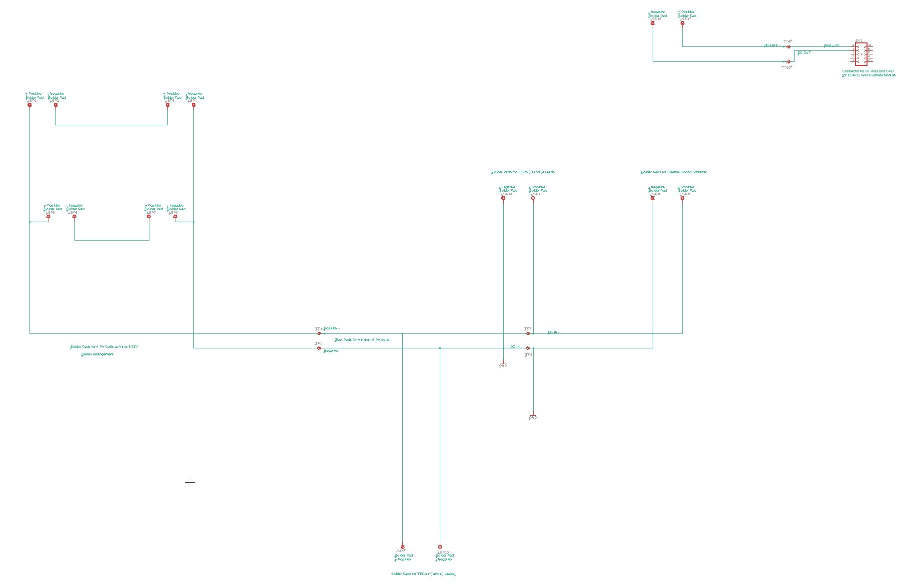
7.

Slide 36
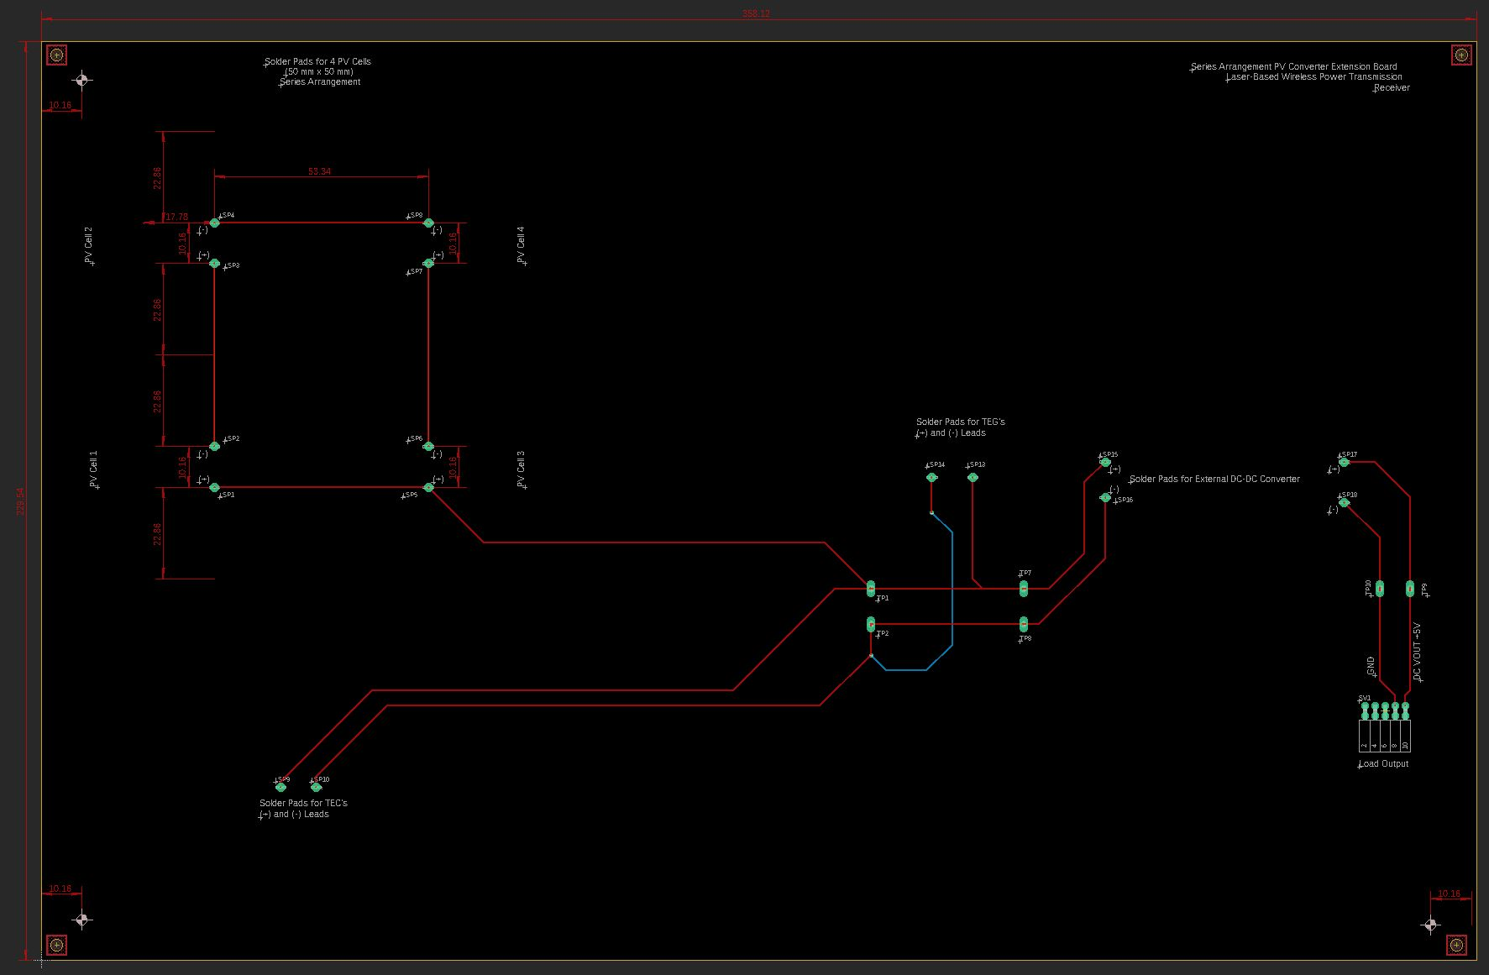
7.

Slide 37
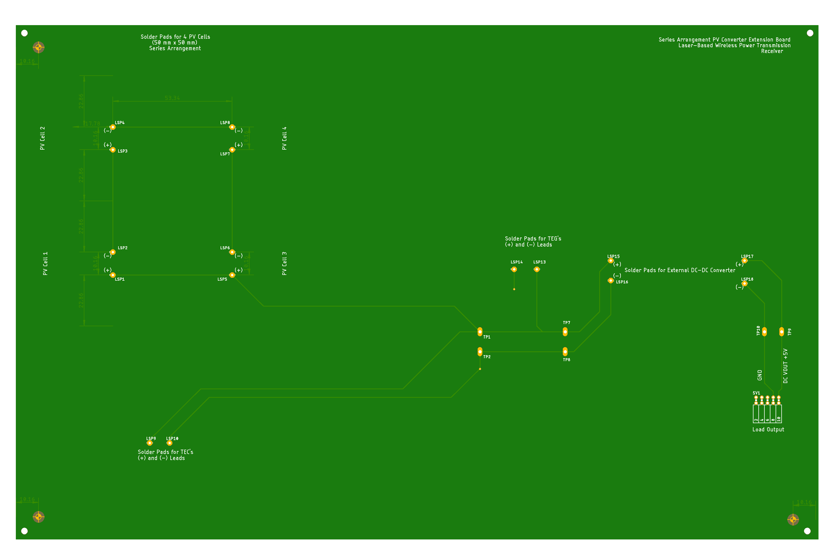
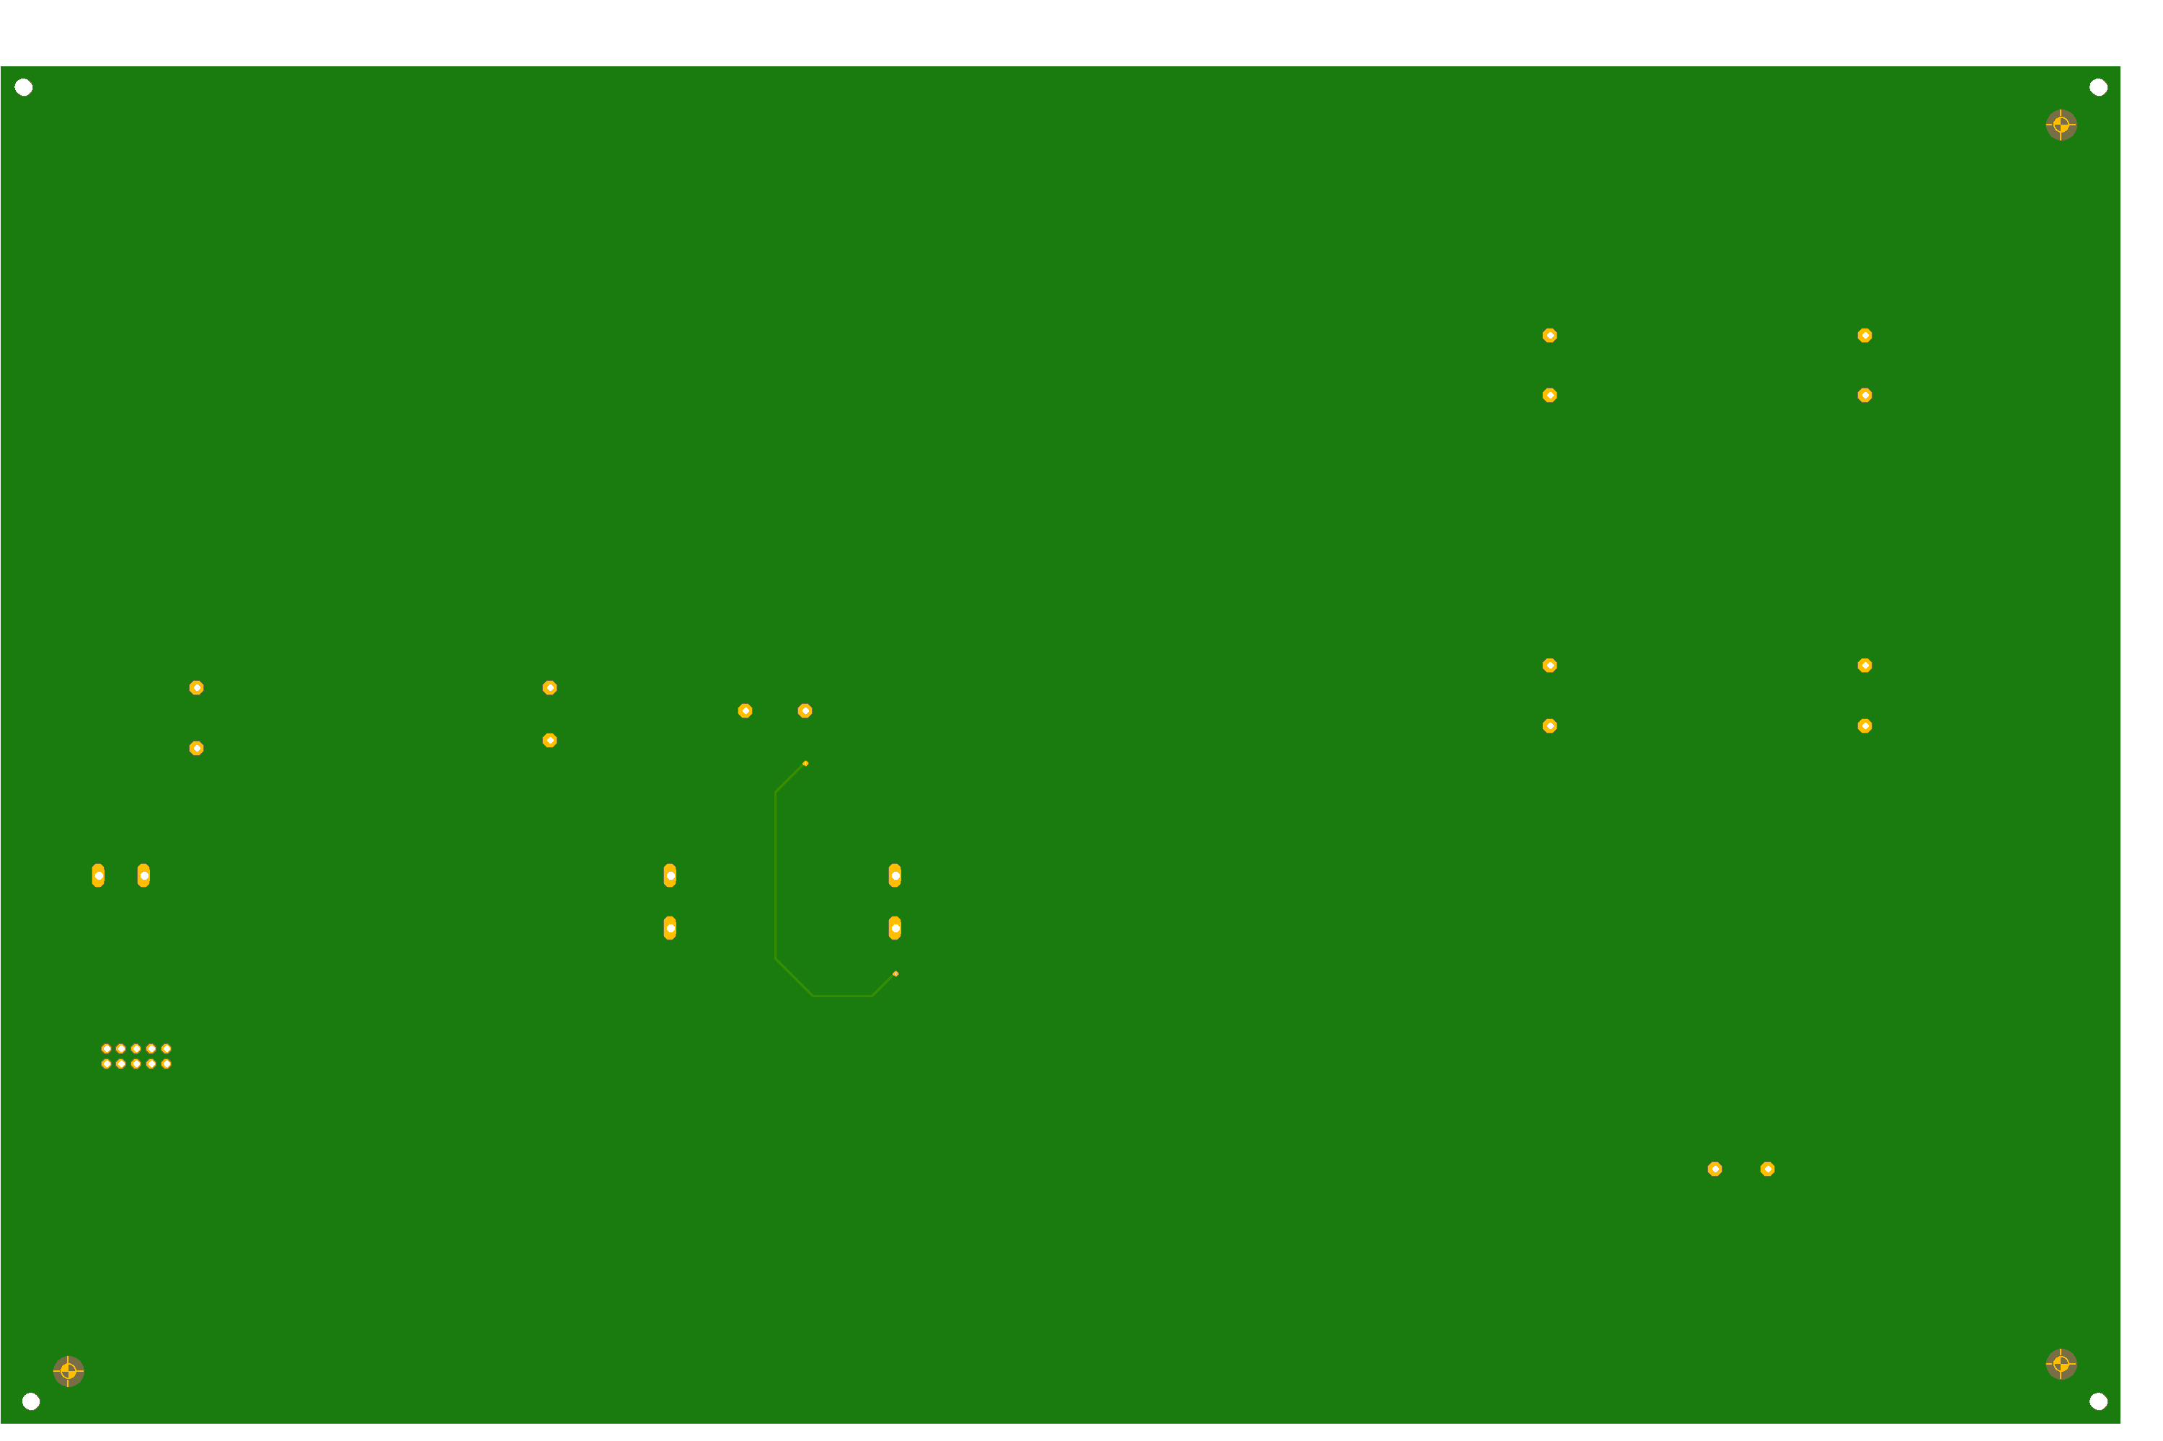
7.
Top
Bottom

Slide 38
8. Design Specifications, 2.5 cm x 2.5 cm PV Cell Form Factor, 4-PV, Parallel; Backplane Extension Board
Peripherals:
Inputs:
PV Array: 2 leads (+ and -)
TEG module’s 2 leads (+ and -)
TEC module’s 2 leads (+ and -)
Outputs:
ESP-32 Wi-Fi camera
Internals:
Pads for soldered PV cells
I/O Ports as Female Connectors
Voltage Requirements:
Input:
Each PV cell has a 0.1053 W maximum power output
Each PV cell has a 2.23 V voltage output at Pmpp
Total V_{out} = 2.23 V for a parallel connection
Total current = 0.0472 A x 4 PV cells = 0.1888 A for a parallel connection
Total power = 2.23 V x 0.1888 A = 0.421024 W
Output: 5 V at 180 mA or 0.18 A = 0.9 W
Miscellaneous:
Heat Sink
*Required Separately: Boost DC-DC Converter circuit: 2.23 V to 5 V

Slide 39
9. Design Specifications, 5 cm x 5 cm PV Cell Form Factor, 4-PV, Parallel; Backplane Extension Board
Peripherals:
Inputs:
PV Array: 2 leads (+ and -)
TEG module’s 2 leads (+ and -)
TEC
Outputs:
ESP-32 Wi-Fi camera
Internals:
Pads for soldered PV cells
I/O Ports as Female Connectors
Voltage Requirements:
Input:
Each PV cell has a 0.34 W power output
Each PV cell has a 2.43 V voltage output
Total V_{out} = 2.43 V for a parallel connection
Total current = 0.14 A x 4 PV cells = 0.56 A for a parallel connection
Total power = 2.43 V x 0.56 A = 1.3608 W
Output: 5 V at 180 mA or 0.18 A = 0.9 W
Miscellaneous:
Heat Sink
*Required Separately: Boost DC-DC Converter circuit: 2.43 V to 5 V

Slide 40
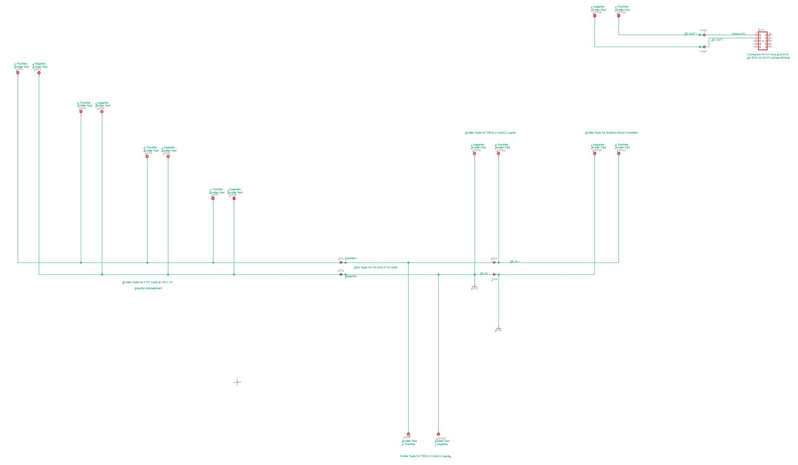
8 & 9.

Slide 41
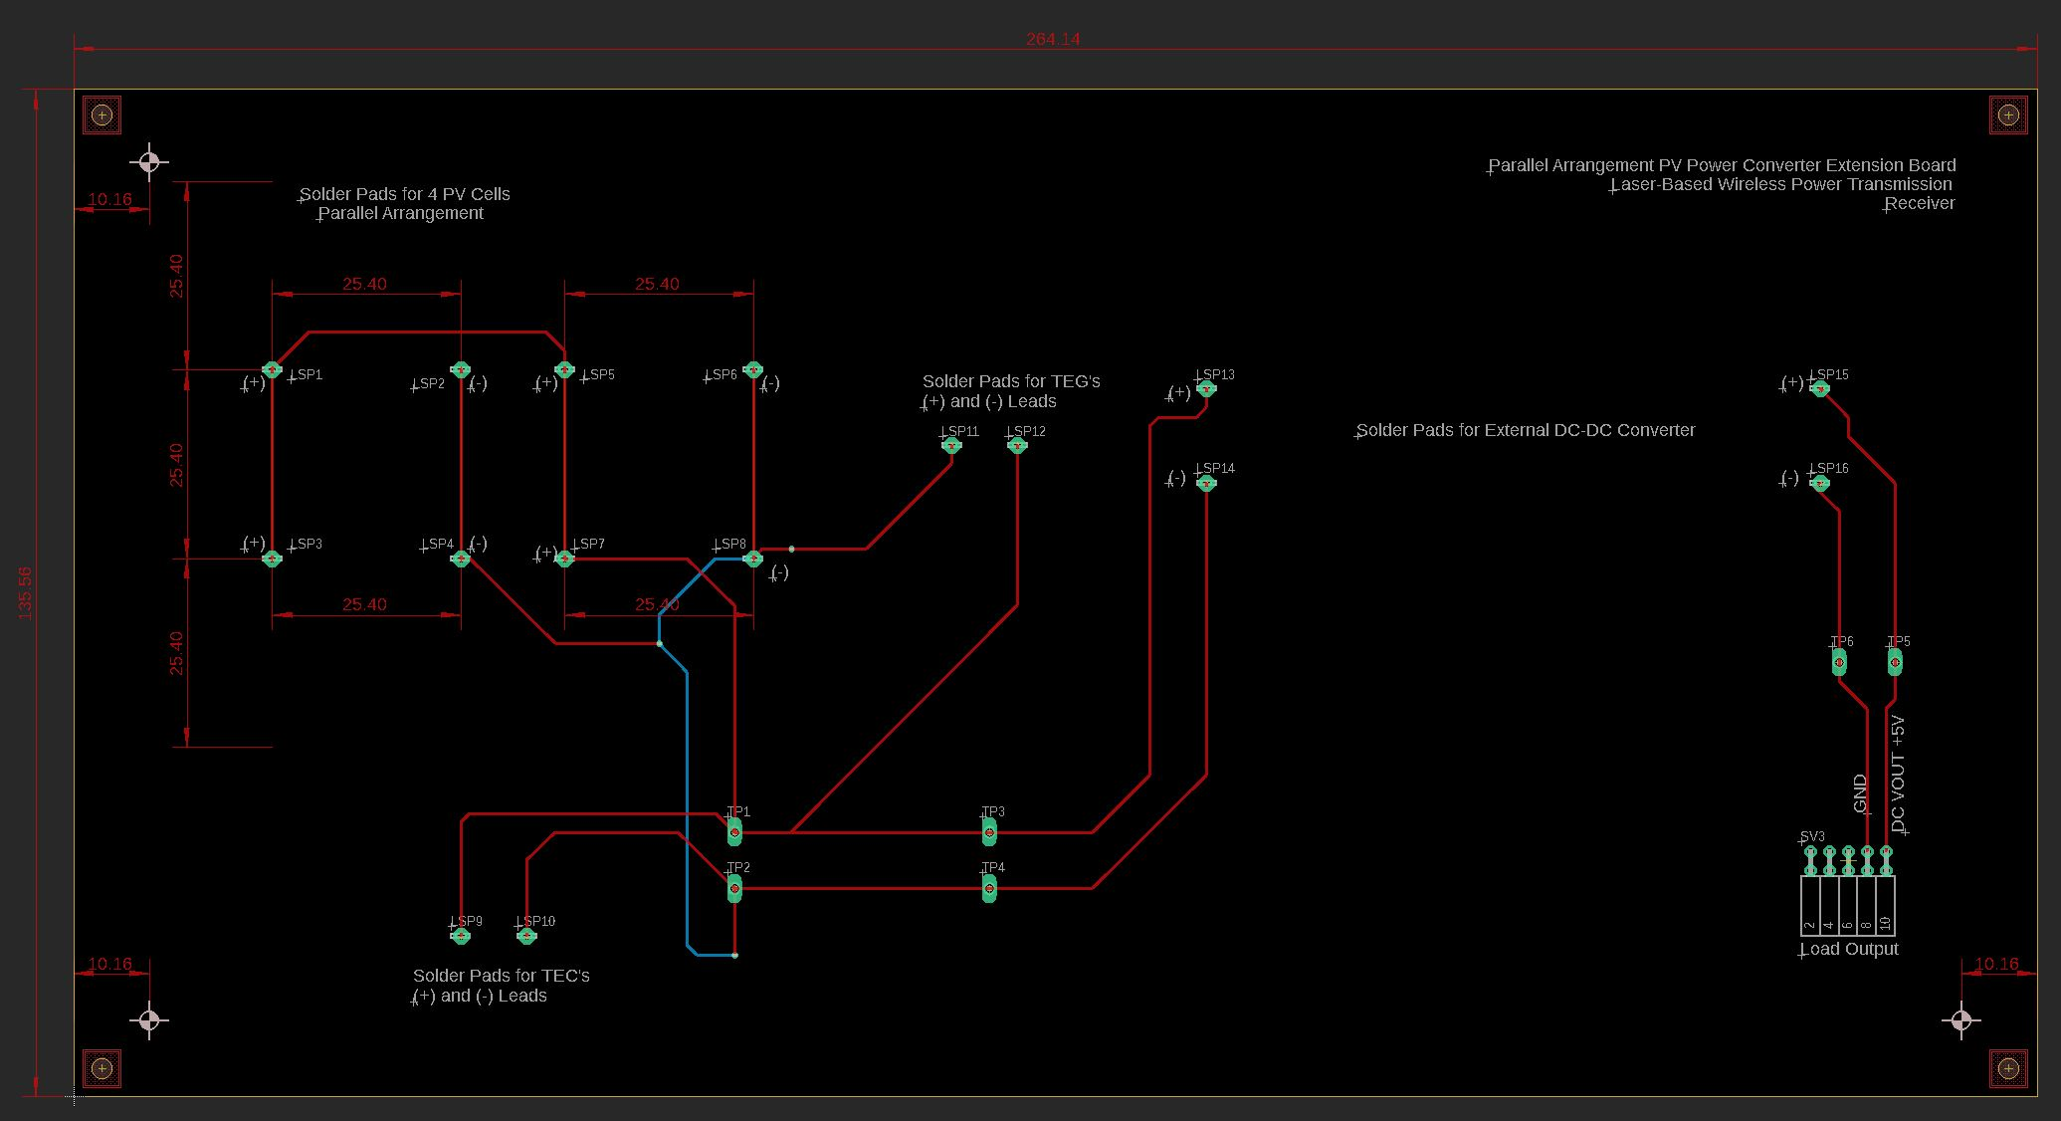
8.

Slide 42
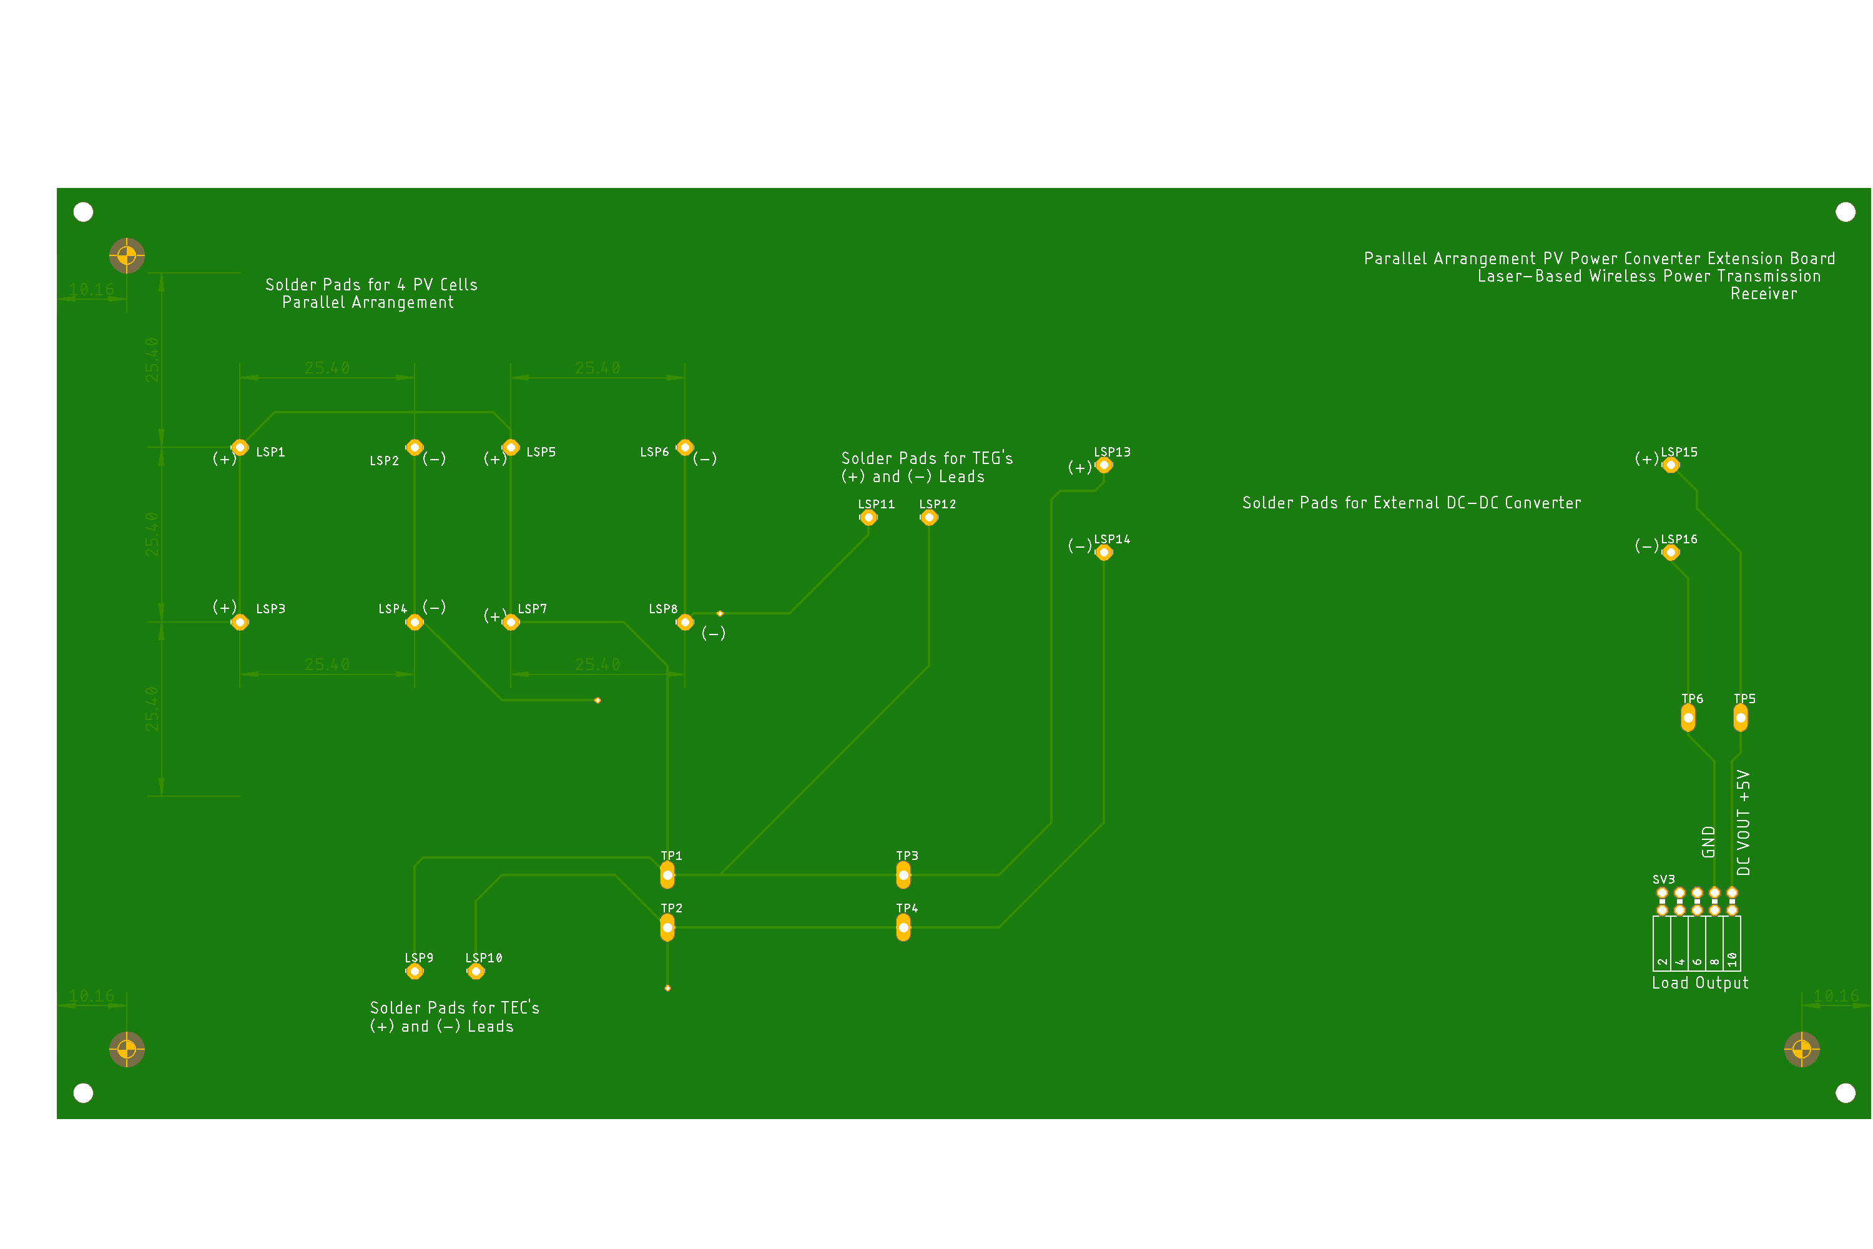
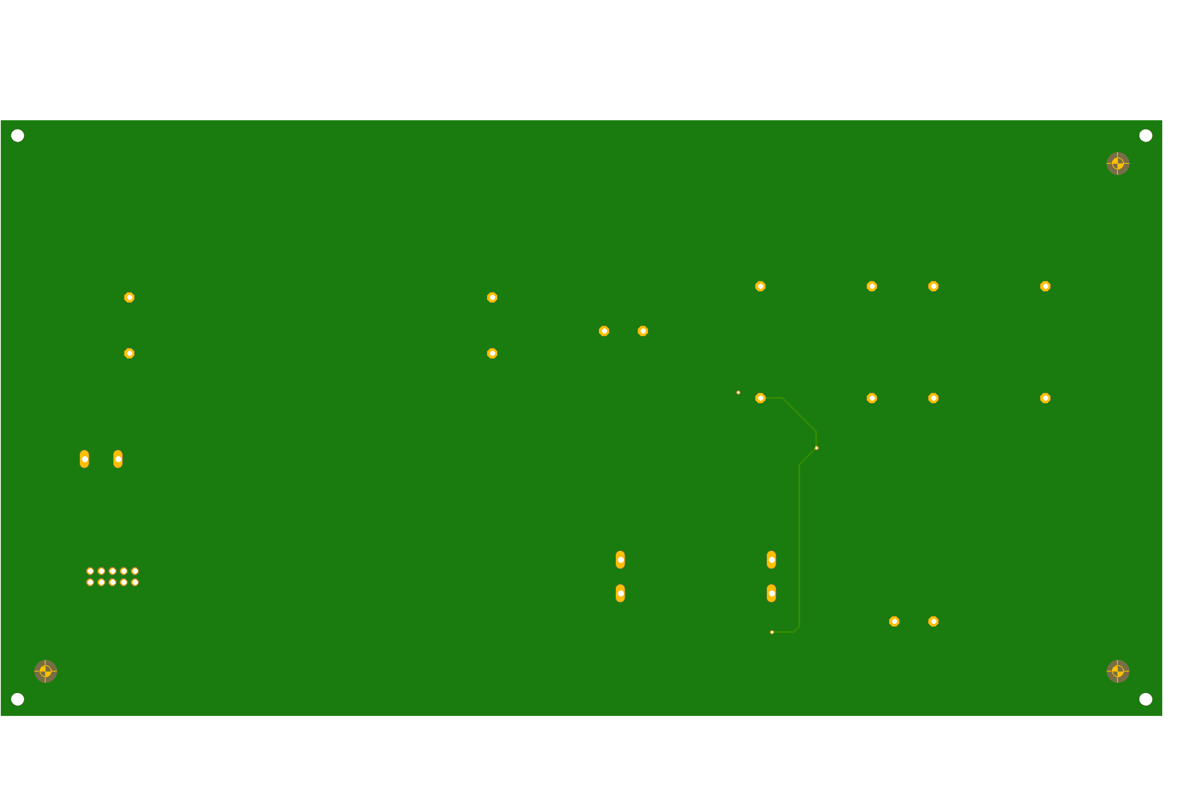
8.
Top
Bottom

Slide 43
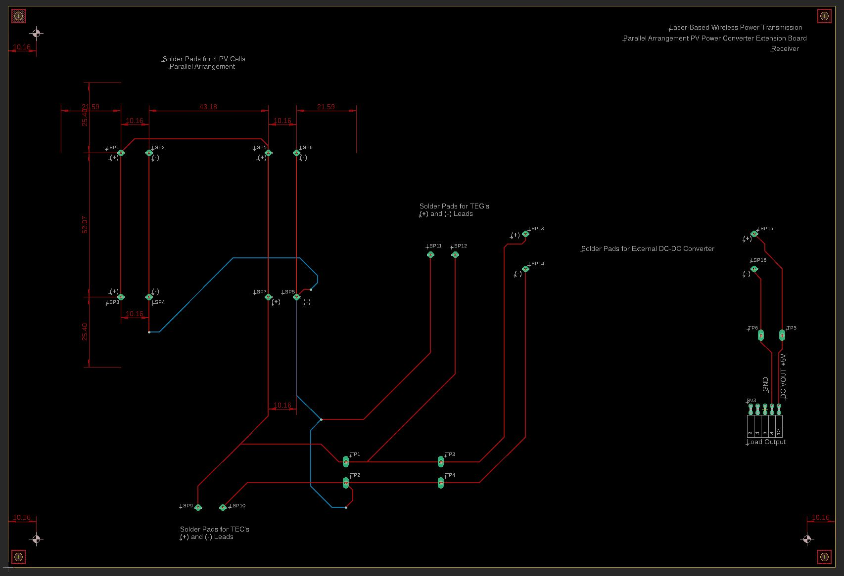
9.

Slide 44
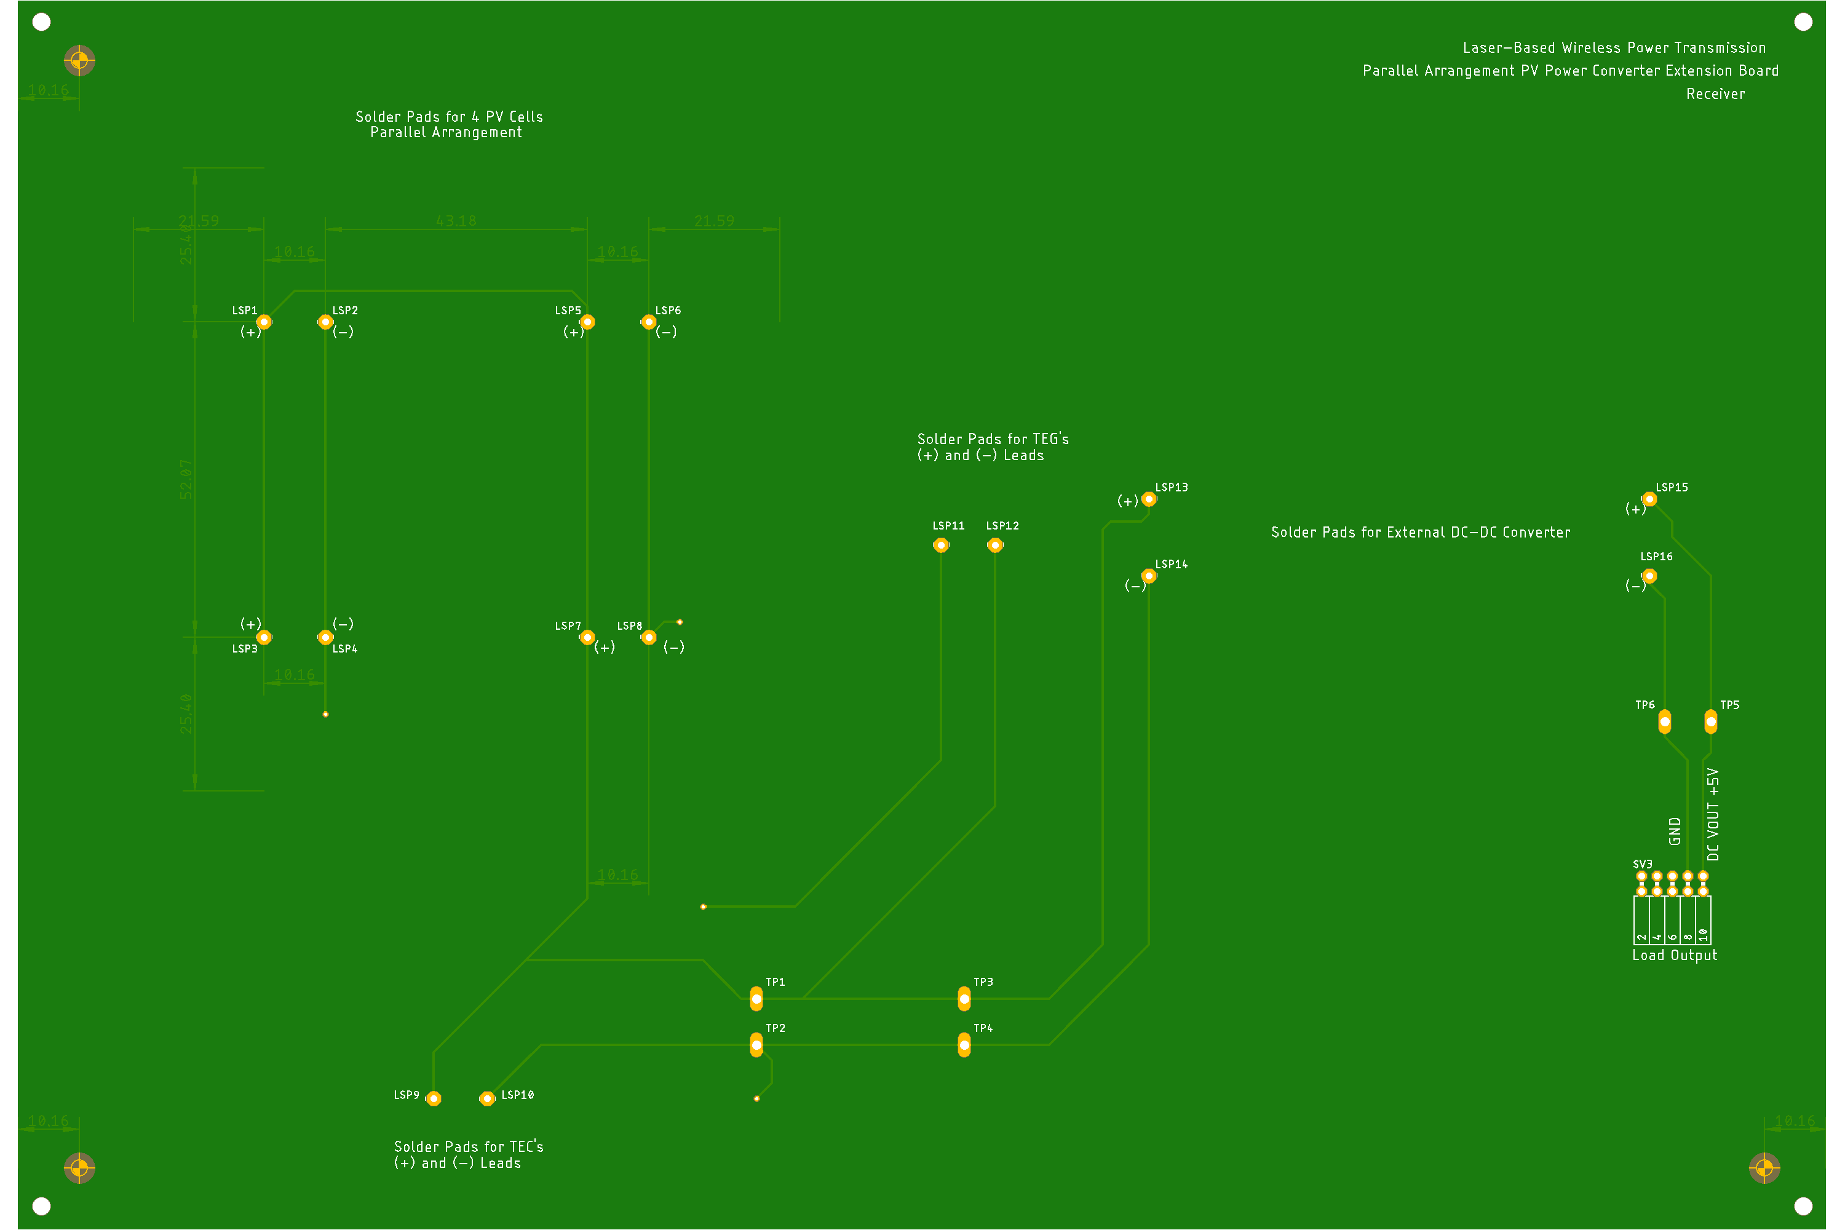
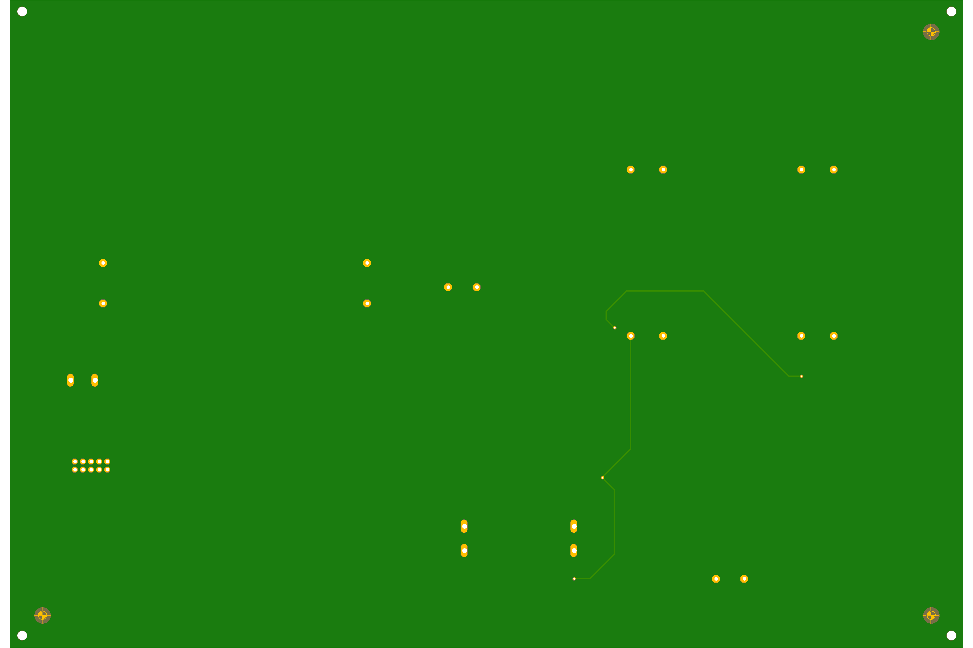
9.
Top
Bottom

Slide 45
Printed Circuit Board Design Standard Performance Considerations (IPC-2221A)
From IPC-2221A Specifications (May 2003):
General Requirements on Trace Thicknesses and Tolerances (pg. 4)
Local and Global Fiducials Clearance and Placement (pg. 34-36)
Mechanical Mounting Hole Placement and Dimensions (pg. 33)
Power distribution considerations (pg. 37)
Method of heatsink mounting (e.g., adhesive bond, rivet, screw, etc.) to printed board (pg. 50-52)
Fabrication: 8 Board Panelization (pg. 36)
(Source: http://www-eng.lbl.gov/~shuman/NEXT/CURRENT_DESIGN/TP/MATERIALS/IPC-2221A(L).pdf)

Slide 46
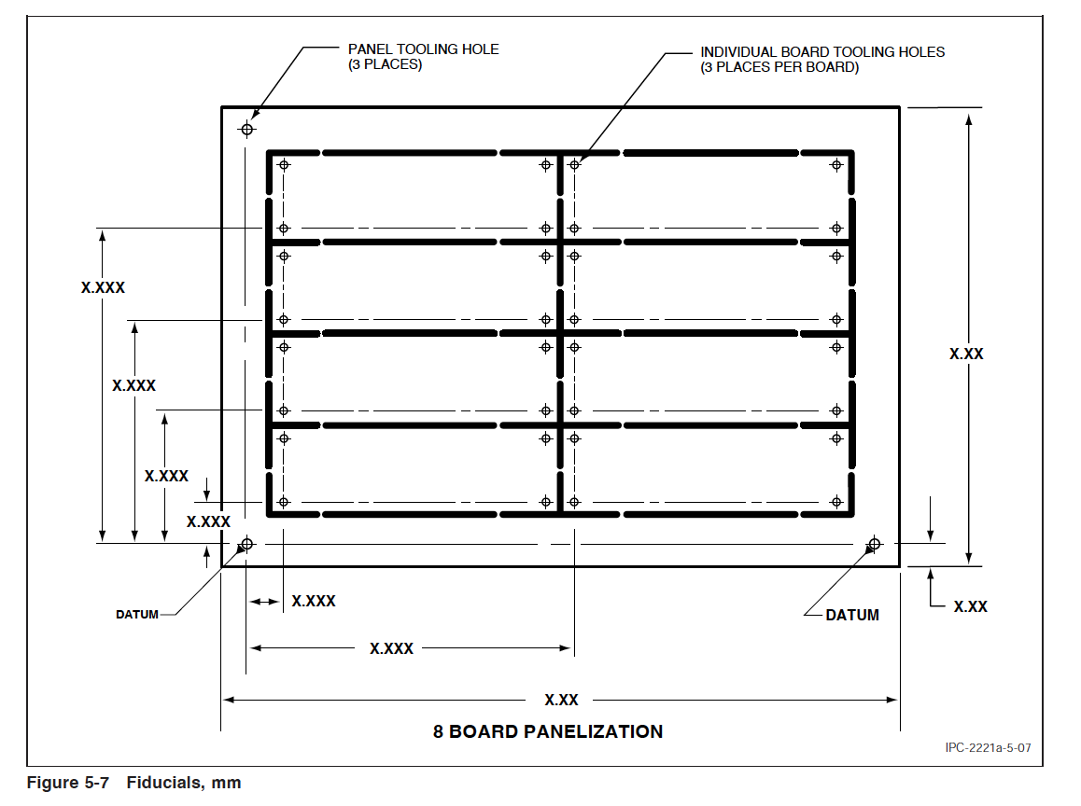
PCB Fabrication: Panelization and Files Generation
Files Generation Requirements from EAGLE:
Download and store predefined CAM files (EAGLE Versions provided by JLCPCB)
2. Generate files for PCB fabrication:
2a. Use CAM Processor in EAGLE
2b. Load CAM Job File and Process Job
2c. Locate ZIP File with Gerber and Drill Files with JLCPCB Naming Conventions
-Delete unnecessary .gpi and .dri files
3. Download a 3rd-party Gerber Viewer Application for final inspection:
3a. Export Gerber/Drill Files into a Gerber Viewer
4. Generate BOM and Centroid Files for SMT for Surface Mount PCB Assembly Service
(Source: https://support.jlcpcb.com/article/137-how-to-generate-gerber-and-drill-files-in-autodesk-eagle)

